Slide 1
Introduction to Machine Learning at AWS
University of Oxford, 10.07.2021
Mustafa Aldemir Senior Prototyping Architect aldemim@amazon.lu
Notes:
First call deck for introduction to Amazon Machine Learning

Slide 2
A Primer
Introduction to Cloud

Slide 3
What is cloud computing?
“Cloud computing is the on-demand delivery of IT resources over the Internet with pay-as-you-go pricing. Instead of buying, owning, and maintaining physical data centers and servers, you can access technology services, such as computing power, storage, and databases, on an as-needed basis from a cloud provider.”

Slide 4





What is the cloud?
On-Premises IT
Internet
Servers
Storage
Databases
Applications
Cloud services provider
Servers Storage
Databases Applications
Corp Network
Internet
4
Notes:
In a traditional, on-premises IT environment, all the physical components required to run business systems were owned, operated, maintained, and housed by the company. A user would connect and log on to the corporate network, and access resources that way. This would include corporate applications, file sharing and storage, etc.
The cloud provides access to the same or similar resources through the internet, as hosted by a cloud services platform. The term itself comes from a time when internet resources or connectivity was often represented by a cloud in diagrams that illustrated connectivity and data flow.

Slide 5

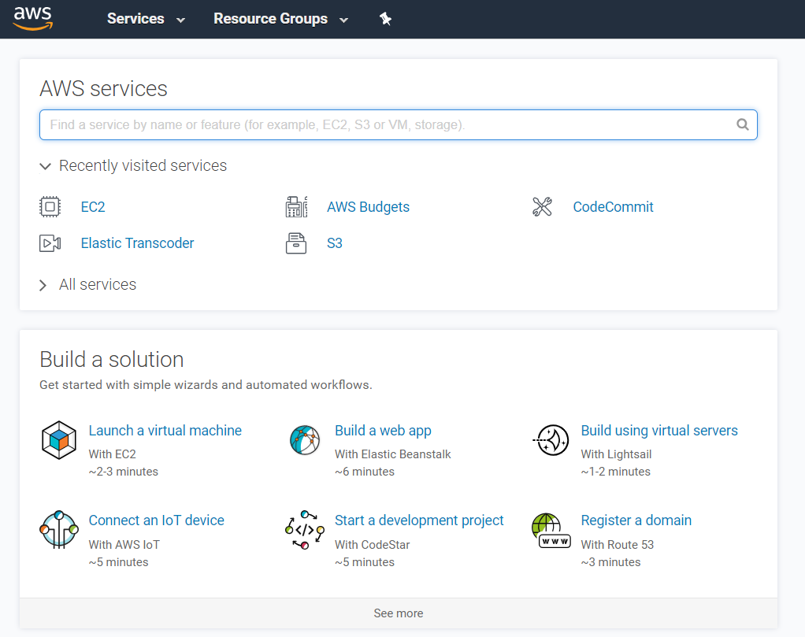







How does cloud work?
AWS owns and maintains the network-connected hardware.
You provision and use what you need.
Notes:
Cloud computing provides a simple way to access servers, storage, databases, and a broad set of application services over the internet . A cloud services platform such as Amazon Web Services (AWS) owns and maintains the network-connected hardware (like servers) that you need to run these application services, while you provision virtual servers called instances and use them via a web application.

Slide 6
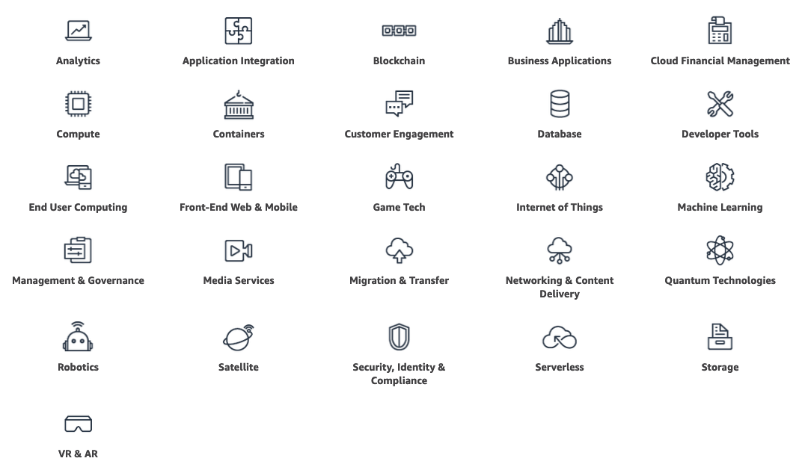
AWS Services

Slide 7

Compute
Compute for any workload - Instances, containers, and serverless computing
Amazon EC2 Virtual Servers in the Cloud | Amazon EC2 Auto Scaling Scale Compute Capacity to Meet Demand | Amazon Lightsail Launch and Manage Virtual Private Servers
AWS App Runner Build and run containerized web apps at scale | AWS Batch Run Batch Jobs at Any Scale | AWS Elastic Beanstalk Run and Manage Web Apps
AWS Lambda Run your Code in Response to Events | AWS Outposts Run AWS services on-premises | AWS Serverless Application Repository Discover, Deploy, and Publish Serverless Applications
AWS Snow Family Physical devices to aggregate and process data in edge locations, then transfer to AWS | AWS Wavelength Deliver ultra-low latency applications for 5G devices | VMware Cloud on AWS Build a Hybrid Cloud without Custom Hardware
https://aws.amazon.com/products

Slide 8

Storage
A reliable, scalable, and secure place for your data
Amazon Simple Storage Service (S3) Scalable Storage in the Cloud | Amazon Elastic Block Store (EBS) EC2 block storage volumes | Amazon Elastic File System (EFS) Fully managed file system for EC2
Amazon FSx for Lustre High-performance file system integrated with S3 | Amazon FSx for Windows File Server Fully managed Windows native file system | Amazon S3 Glacier Low-cost Archive Storage in the Cloud
AWS Backup Centralized backup across AWS services | AWS Snow Family Physical edge computing and storage devices for rugged or disconnected environments | AWS Storage Gateway Hybrid Storage Integration
https://aws.amazon.com/products

Slide 9

Database
The broadest selection of purpose-built databases for all your application needs
Amazon Aurora High Performance Managed Relational Database | Amazon Aurora Serverless v2 (Preview) Instantly scale to >100,000 transactions per second | Amazon DynamoDB Managed NoSQL Database
Amazon DocumentDB Fully managed document database | Amazon ElastiCache In-memory Caching System | Amazon Keyspaces (for Apache Cassandra) Managed Cassandra-compatible database
Amazon Neptune Fully Managed Graph Database Service | Amazon Quantum Ledger Database (QLDB) Fully managed ledger database | Amazon RDS Managed Relational Database Service for MySQL, PostgreSQL, Oracle, SQL Server, and MariaDB
Amazon Redshift Fast, Simple, Cost-effective Data Warehousing | Amazon Timestream Fully managed time series database | AWS Glue Simple, scalable, and serverless data integration
https://aws.amazon.com/products

Slide 10

Analytics
Fastest way to get answers from all your data to all your users
Amazon Athena Query Data in S3 using SQL | Amazon Elasticsearch Service Run and Scale Elasticsearch Clusters | Amazon EMR Hosted Hadoop Framework
Amazon Kinesis Work with Real-time Streaming Data | Amazon Managed Streaming for Apache Kafka Fully managed Apache Kafka service | Amazon Redshift Fast, Simple, Cost-effective Data Warehousing
Amazon QuickSight Fast Business Analytics Service | AWS Glue Simple, scalable, and serverless data integration | AWS Lake Formation Build a secure data lake in days
https://aws.amazon.com/products

Slide 11

Application integration
Integrate distributed systems and serverless applications with less code
AWS Step Functions Coordinate Distributed Applications | Amazon AppFlow No code integration for SaaS apps & AWS services | Amazon EventBridge Serverless event bus for SaaS apps & AWS services
Amazon MQ Managed Message Broker Service | Amazon Simple Notification Service (SNS) Pub/sub, SMS, email, and mobile push notifications | Amazon Simple Queue Service (SQS) Managed Message Queues
Amazon AppSync Power your apps with the right data from many sources, at scale
https://aws.amazon.com/products

Slide 12

Internet of Things (IoT)
IoT services for industrial, consumer, and commercial solutions
AWS IoT Core Connect Devices to the Cloud | AWS Greengrass Local Compute, Messaging, and Sync for Devices | AWS IoT Analytics Analytics for IoT Devices
AWS IoT Button Cloud Programmable Dash Button | AWS IoT Device Defender Security Management for IoT Devices | AWS IoT Device Management Onboard, Organize, and Remotely Manage IoT Devices
AWS IoT Events IoT event detection and response | AWS IoT SiteWise IoT data collector and interpreter | AWS IoT Things Graph Easily connect devices and web services
FreeRTOS Real-time operating system for microcontrollers
https://aws.amazon.com/products

Slide 13
Introduction to Machine Learning at AWS

Slide 14
The reach of ML is growing
INCREASED SPENDING
FROM PILOTING TO OPERATIONALIZING
AI TRANSFORMATION
By 2024, global spending on artificial intelligence will reach $110 billion
—IDC
By the end of 2024, 75% of enterprises will shift from piloting to operationalizing AI
—Gartner
57% said that AI would transform their organization in the next three years
—Deloitte
Notes:
Machine learning went from being an aspirational technology to mainstream extremely fast.
For a long time, the technology was limited to a few major tech companies and hardcore academic researchers.
But, things began to change when cloud computing entered the mainstream.
Compute power and data became more available, and quite literally, machine learning is now making an impact across every industry (finance, retail, fashion, real estate, healthcare etc.).
It’s moving from the peripheral to now a core part of every business and industry.
https://www.gartner.com/en/newsroom/press-releases/2020-06-22-gartner-identifies-top-10-data-and-analytics-technolo
https://www2.deloitte.com/us/en/insights/focus/cognitive-technologies/state-of-ai-and-intelligent-automation-in-business-survey.html
https://www.idc.com/getdoc.jsp?containerId=prUS46794720

Slide 15




Transform customer experience
Improve business operations
Better and faster decision-making
Innovation
Notes:
And at AWS, we’re seeing a tipping point, where AI/ML in the enterprise is addressing use cases that create measurable results.
Customer experience is being transformed via capabilities such as conversational interfaces, smart biometric authentication, and personalization and recommendations.
Business operations are being improved with sophisticated demand planning and forecasting models.
In retails, AI-based demand forecasting reduced errors by 30-50%, with lost sales due to product unavailability reduced by up to 65%. (“Artificial Intelligence: The Next Digital Frontier?” June 2017, McKinsey Global Institute.)
Automation is making supply chain management more efficient. Using AI to predict sources of servicing revenues and to optimize sales efforts can increase EBIT by 13%. (“Artificial Intelligence: The Next Digital Frontier?” June 2017, McKinsey Global Institute.)
AI/ML is helping companies make better and faster decisions. In healthcare, we’re seeing a shift from reactive to predictive care, including the use of predictive models to accelerate research and discovery of new drugs and treatments regiment. Nurses supported by AI tools can increase productivity by up to 50%. (“Artificial Intelligence: The Next Digital Frontier?” June 2017, McKinsey Global Institute.)
And AI/ML is helping companies create new products, services and business models to innovate and gain competitive advantage.

Slide 16



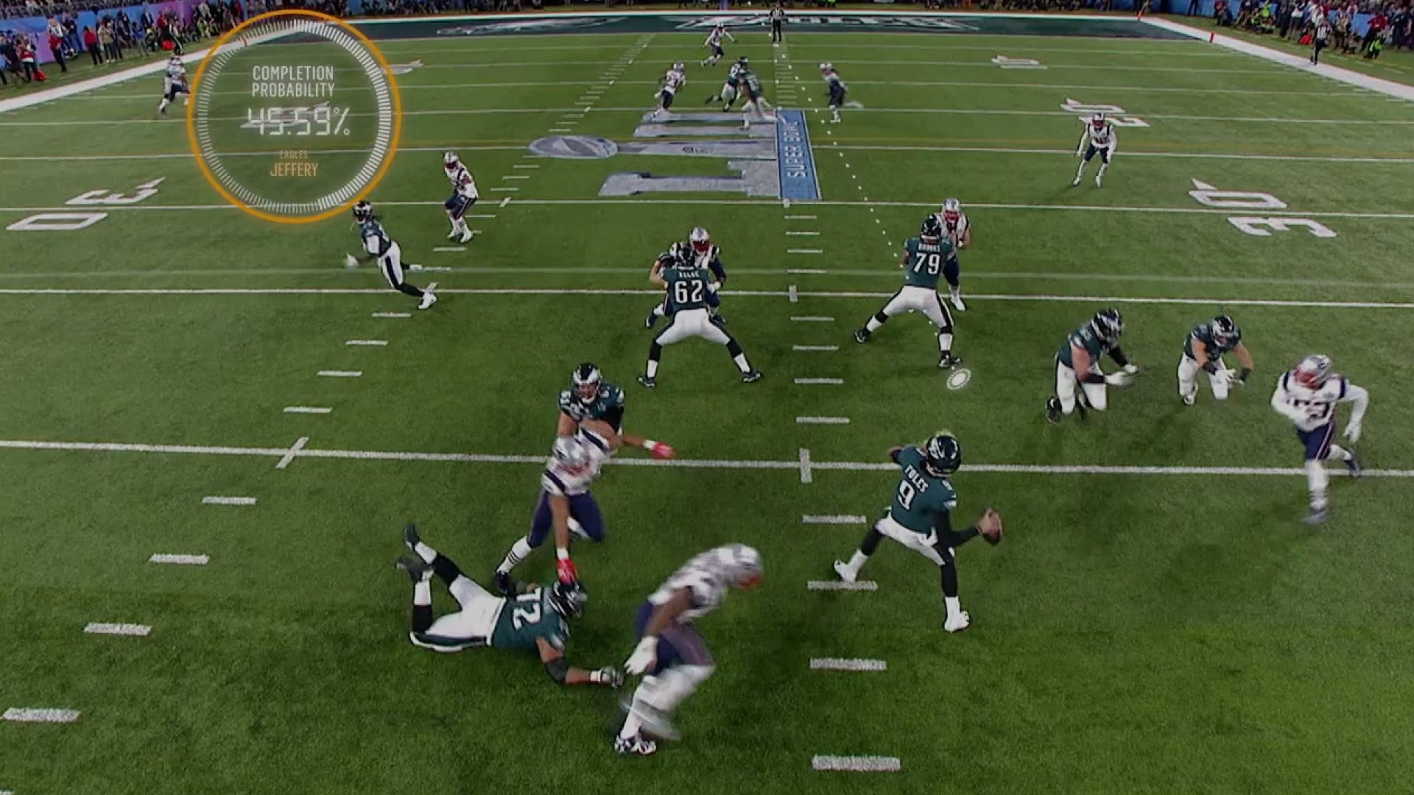
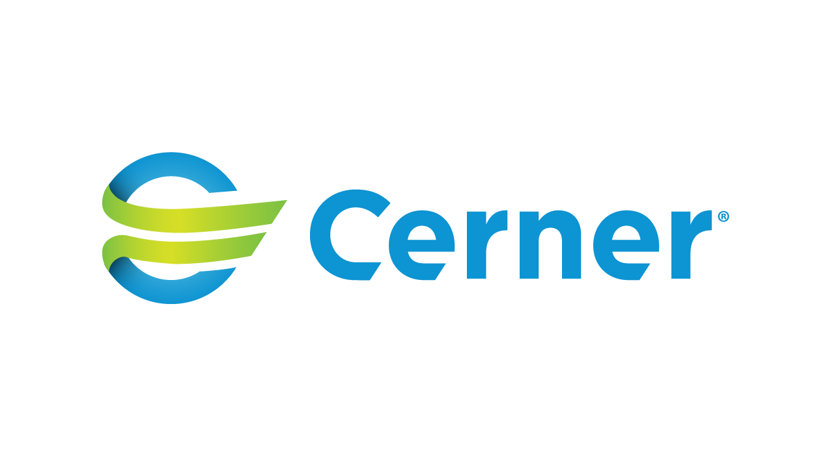



Notes:
Let’s take a look at how our customer are doing this. In customer experience, Intuit has built forecasting capabilities to predict call center demand on a particular day or time to make sure customer service agents are adequately staffed.
Convoy, a Seattle-based logistics company, is building their entire company and value proposition off the use of machine learning. The company is disrupting the inefficient trucking model by using machine learning to automate it. Convoy uses machine learning to provide better matches for shippers and truckers, allowing them to move freight more efficiently—and lowering costs for both parties—using Convoy’s matching system.
In healthcare, Cerner, an American supplier of health information technology solutions, services, devices, and hardware is tapping into AWS’s deep portfolio of machine learning and AI services including Transcribe Medical to surface insights that will help their healthcare provider customers streamline operations and provide more personalized patient care. They’ve already developed a model that predicts Congestive Heart Failure up to 15 months before clinical manifestation. Pairing this predictive tool with real-time integration in to individual health records can support provider decision making in real-time
And in sports, we’ve been working with the NFL to create Next Gen Stats to engage fans by combining old and new data to reveal insights about game dynamics for both fans and players. We have now developed over 20 unique Next Gen Stats that are used on-screen during games in real time, by broadcasters and partners, online for fans, and more. The most exciting stats use predictive machine learning models built on Amazon SageMaker that highlight the athleticism like never before, and it’s just getting started bringing the data to life.
But, even with the increasing adoption of Machine Learning and much hype associated with the technology, it is still in its infancy.
We are just scratching the surface of the impact that ML can have across industries and geographies.

Slide 17

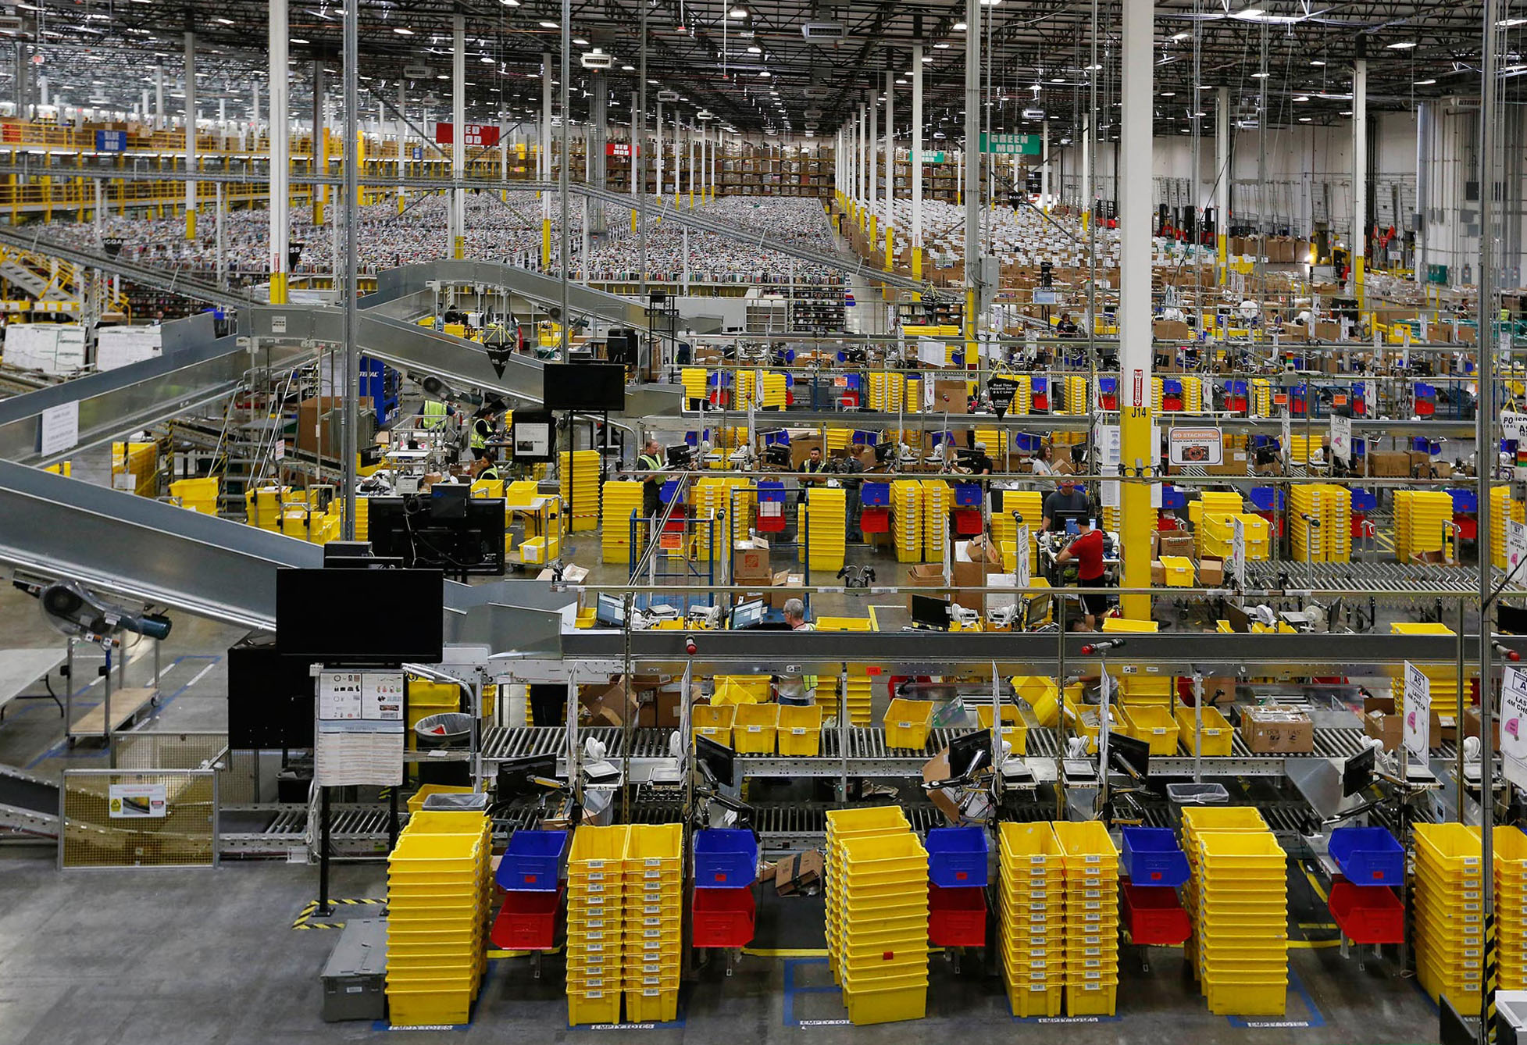
Amazon’s machine learning innovation at scale
4,000 products per minute sold on Amazon.com
1.6M packages every day
Billions of Alexa interactions each week
First Prime Air Delivery on Dec. 7, 2016
Notes:
Amazon itself is an example of a company that went through a multi-year machine learning journey in order to be the ML-driven company you see today.
Amazon had been applying ML in areas such as personalization and supply chain for more than 20 years. ML is an integral part of Amazon.
We’ve improved that original personalization model significantly over time and moved it to other products such as Amazon Prime.
We use ML throughout our fulfillment process including developing a forecast system that can predict the appropriate amount of demand for each product we sell worldwide in order to deliver on our customer expectation on convenience, cost, and delivery speed.
We’ve developed natural language processing technology to give consumers an entirely new way to interact with technology through Alexa.
We’re also developed ground breaking technology with autonomous flight via Prime Air Drones and using robotics in our fulfillment center to get packages to consumers faster.
This was a big culture change for us, but it’s something every organization can do.

Slide 18




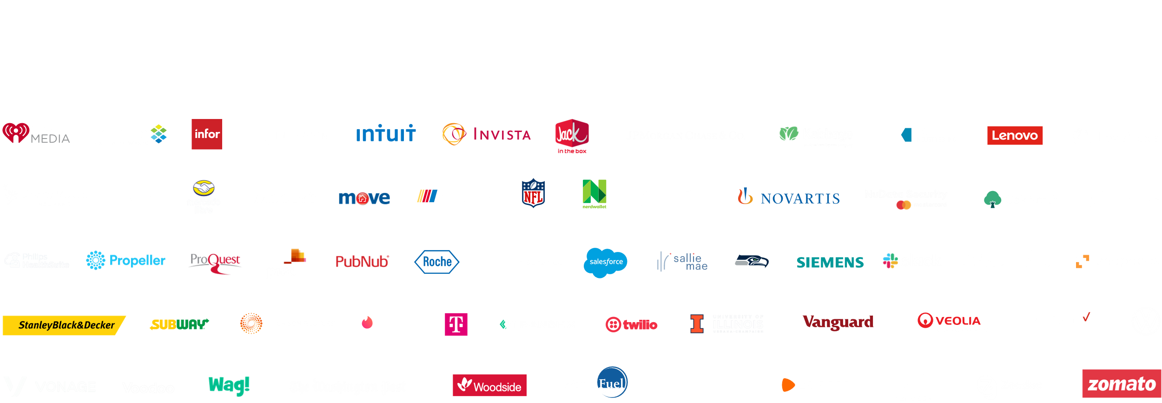





More than one hundred thousand customers use AWS for machine learning
Notes:
Machine learning is one of the most disruptive technologies we will encounter in our generation. More than one hundred thousand customers use AWS for machine learning today from creating a more personalized customer experience to developing personalized pharmaceuticals.

Slide 19

AWS is uniquely equipped to help you achieve ML success
AI/ML challenges + needs
AWS capabilities
Massive compute and storage
Undisputed leader in compute and storage on demand
Implementing a data strategy
Most of the data in the cloud is on AWS
AI Services require no ML expertise + AWS Training, DeepRacer, ML Solutions Lab
Lack of ML talent
Experience and expertise
Built on 20+ years of Amazon’s experience in machine learning + more than 100K customers
Reducing complexity
SageMaker increases data science team productivity 10x
Addressing business value
Use case and industry solutions solve business problems
Notes:
For all the progress we have made in machine learning, there are still real challenges to getting machine learning off the ground and AWS can help.
ML relies on a foundation of compute and storage, and ML’s gigantic storage and compute needs are most effectively addressed in the cloud. AWS is the undisputed leader in the cloud and provides the best storage and compute capabilities.
According to McKinsey Global AI Survey 2019, 65 percent from the high performers report having a clear data strategy that supports and enables AI, compared with 20 percent from other companies. ML requires data and most of the data is on AWS. Data has gravity and we believe that gravity makes AWS well suited to provide ML services.
According to the Gartner’s 2019 CIO Agenda survey, skill of staff is rated the number one blocker to AI adoption with 56% of people citing it as a blocker. AWS provides ready-made intelligence, no ML expertise required with our AI Services and we provide trainings, educational devices like DeepRacer and the ML Solutions Lab to help fill this gap.
ML is new and there aren’t well-worn paths to success. Amazon has been investing in and using ML for the last twenty years in its products (e.g. recommendation, personalization, Alexa, etc.) and has some of the most sophisticated ML deployments in production. We are able to harness the accumulated knowledge of deploying ML to build ML services for our customers. Moreover, Amazon’s internal ML users also use our services for their needs which provides us a quick, high-quality feedback loop. And we helped more than 100,000 customer achieve ML success.
ML is complex and can be resource intensive. SageMaker, our end-to-end services for machine learning increases data science team productivity by 10x by making it easier and faster to build, train, and deploy ML models.
Lastly, ML has to be tied to business objectives to be successful and we have use case and industry-specific solutions built to solve common business problems end-to-end.

Slide 20
Technology
Bringing ML into your digital transformation requires a new “stack” that makes it easier to put ML to work
Notes:
On the technology side, ML should increasingly be integrated into just about every aspect of your business.
To do so, requires a new stack that is tailored to the unique needs of your business.

Slide 21
The AWS ML stack Broadest and most complete set of machine learning capabilities
Vision
Chatbots
Business tools
Search
Healthcare
Rekognition
Lex
Personalize ,Forecast Fraud Detector
Lookout for Metrics
Kendra
HealthLake
Comprehend Medical
Transcribe Medical
AI SERVICES
Speech
Text
Contact centers
Code + DevOps
Industrial
Polly Transcribe
Comprehend Translate Textract
Contact Lens Connect Voice ID
CodeGuru DevOps Guru
Panorama Appliance and SDK, Monitron, Lookout for Equipment, Lookout for Vision
SAGEMAKER STUDIO IDE
Label data
Data collection prep
Store features
Detect bias and explain predictions
Visualize in notebooks
Pick algorithm
Train models faster
Tune parameters
Deploy in production
Manage & monitor
Manage edge devices
AMAZON SAGEMAKER
CI/CD
ML FRAMEWORKS & INFRASTRUCTURE
TensorFlow, PyTorch, Apache MXNet
Deep learning AMIs & containers
GPUs
Inferentia
Elastic inference
FPGA
Notes:
We’re innovating on behalf of our customers to deliver the broadest and deepest set of machine learning capabilities for builders of all levels of expertise. At each layer of the stack, we’re investing in removing the undifferentiated heavy lifting so your teams can move faster. These services are applicable across a broad spectrum of companies, but we’ve also heard from customers that they want specific solutions that are purpose-built for their industries so we are investing in industrials and healthcare.
At the top layer are our AI Services, which allow developers to easily add intelligence to any application without needing ML skills. The pre-trained models provide ready-made intelligence for your applications and workflows to help you do things like personalize the customer experience, forecast business metrics, translate conversations, extract meaning from documents and more. At the middle layer is Amazon SageMaker, which provides every developer and data scientist with the ability to build, train, and deploy machine learning models at scale. It removes the complexity from each step of the machine learning workflow so you can more easily deploy your machine learning use cases, anything from predictive maintenance to computer vision to predicting customer behaviors. Customer achieve up to 10 times improvement in data scientists’ productivity with Amazon SageMaker. And at the bottom layer, expert practitioners can develop on the framework of their choice as a managed experience in Amazon SageMaker or use the AWS Deep Learning AMIs (Amazon machine images), which are fully configured with the latest versions of the most popular deep learning frameworks and tools.

Slide 22
The AWS ML stack Broadest and most complete set of machine learning capabilities
Vision
Chatbots
Business tools
Search
Healthcare
Rekognition
Lex
Personalize Forecast Fraud Detector
Lookout for Metrics
Kendra
HealthLake
Comprehend Medical
Transcribe Medical
AI SERVICES
Speech
Text
Contact centers
Code + DevOps
Industrial
Polly Transcribe
Comprehend Translate Textract
Contact Lens Connect Voice ID
CodeGuru DevOps Guru
Panorama Appliance and SDK, Monitron, Lookout for Equipment, Lookout for Vision
SAGEMAKER STUDIO IDE
Label data
Data collection prep
Store features
Detect bias and explain predictions
Visualize in notebooks
Pick algorithm
Train models faster
Tune parameters
Deploy in production
Manage & monitor
Manage edge devices
AMAZON SAGEMAKER
CI/CD
ML FRAMEWORKS & INFRASTRUCTURE
TensorFlow, PyTorch, Apache MXNet
Deep learning AMIs & containers
GPUs
Inferentia
Elastic inference
FPGA
Notes:
We think about ML at a macro level as having 3 layers of the stack…
At the bottom layer is the frameworks, interfaces, and infrastructure for expert ML practitioners
At the frameworks layer, there are three frameworks that are predominantly used: TensorFlow, PyTorch, and MXNet.
Today, 92% of cloud-based TensorFlow and 91% of cloud-based PyTorch runs on AWS.
New algorithms are being developed all the time in different frameworks that people want to borrow from, or run in that framework – instead of having to port it themselves to a different framework. So we have dedicated teams for all of the major frameworks so customers have the right tool for the right job.
AWS provides the broadest and deepest portfolio of ML infrastructure services with a choice of processors and accelerators to meet your unique performance and budget needs. Amazon EC2 P4d instances provide the highest performance for ML training in the cloud with the latest NVIDIA A100 Tensor Core GPUs coupled with first in the cloud 400 Gbps instance networking. P4d instances are deployed in hyper scale clusters, called EC2 UltraClusters, offering supercomputer-class performance for the most complex ML training jobs. For inference, Amazon EC2 Inf1 instances, powered by AWS Inferentia chips, provide high performance and lowest cost inference in the cloud.

Slide 23
Machine learning inference dominates ML infrastructure cost
1
Cost to run ML models in production dominates the overall infrastructure costs to develop and run ML applications
2
ML practitioners are creating increasing complex models that are prohibitively more expensive to run in production
Notes:
Organizations are rapidly adopting the use of deep learning to build never seen before applications. Coupled with a rapid increase in model complexity, the cost to build, train and deploy machine learning applications quickly adds up.
Machine learning inference can represent up to 90% of the overall operational costs for running machine learning applications in production
Amazon EC2 Inf1 instances deliver high performance and the lowest cost machine learning inference in the cloud. Inf1 instances are built from the ground up to support machine learning inference applications. They feature up to 16 AWS Inferentia chips, high-performance machine learning inference chips designed and built by AWS.

Slide 24
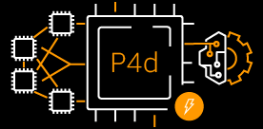
Introducing Amazon EC2 P4d instances
P4d instances
Up to 60% lower cost to train ML model, 2.5x more deep learning performance and 25% more GPU memory
Powered by 8 NVIDIA A100 GPUs, 400 Gbps of network bandwidth, and capable of 2.5 PetaFLOPS of performance
The most powerful GPU instances in the cloud
Deployed in UltraClusters consisting of thousands of tightly coupled GPUs, ideal for ML training and HPC
Notes:
Amazon EC2 P4d instances deliver the highest performance for machine learning (ML) training and high performance computing (HPC) applications in the cloud. P4d instances are powered by the latest NVIDIA A100 Tensor Core GPUs and deliver industry-leading high throughput and low latency networking.
These instances are the first in the cloud to support 400 Gbps instance networking. P4d instances provide up to 60% lower cost to train ML models, including an average of 2.5x better performance for deep learning models compared to previous generation P3 and P3dn instances.

Slide 25
The AWS ML stack Broadest and most complete set of machine learning capabilities
Vision
Chatbots
Business tools
Search
Healthcare
Rekognition
Lex
Personalize Forecast Fraud Detector
Lookout for Metrics
Kendra
HealthLake
Comprehend Medical
Transcribe Medical
AI SERVICES
Speech
Text
Contact centers
Code + DevOps
Industrial
Polly Transcribe
Comprehend Translate Textract
Contact Lens Connect Voice ID
CodeGuru DevOps Guru
Panorama Appliance and SDK, Monitron, Lookout for Equipment, Lookout for Vision
SAGEMAKER STUDIO IDE
Label data
Data collection prep
Store features
Detect bias and explain predictions
Visualize in notebooks
Pick algorithm
Train models faster
Tune parameters
Deploy in production
Manage & monitor
Manage edge devices
AMAZON SAGEMAKER
CI/CD
ML FRAMEWORKS & INFRASTRUCTURE
TensorFlow, PyTorch, Apache MXNet
Deep learning AMIs & containers
GPUs
Inferentia
Elastic inference
FPGA
Notes:
There’s not that many expert ML practitioners, so if you want ML to be pervasive, you have to make it easier for everyday developers and data scientists to build, train, and tune ML models. And that’s what the middle layer of the stack is for.

Slide 26
Amazon SageMaker: Built to make ML more accessible
Label data
Collect and prepare data
Store features
Check data
Visualize in notebooks
Pick algorithm
Train models
Tune parameters
Deploy in production
Manage and monitor
CI/CD
SageMaker Studio IDE
Notes:
We built Amazon SageMaker from the ground up to provide every developer and data scientist with the ability to build, train, and deploy ML models quickly and at lower cost by providing the tools required for every step of the ML development lifecycle in one integrated, fully managed service. In fact, we have launched 50+ capabilities in the past year alone, all aimed at making this process easier for our customers.
And last year we launched Amazon SageMaker Studio to bring this all together in a single pane of glass so that you get access to all your tools in one place.

Slide 27
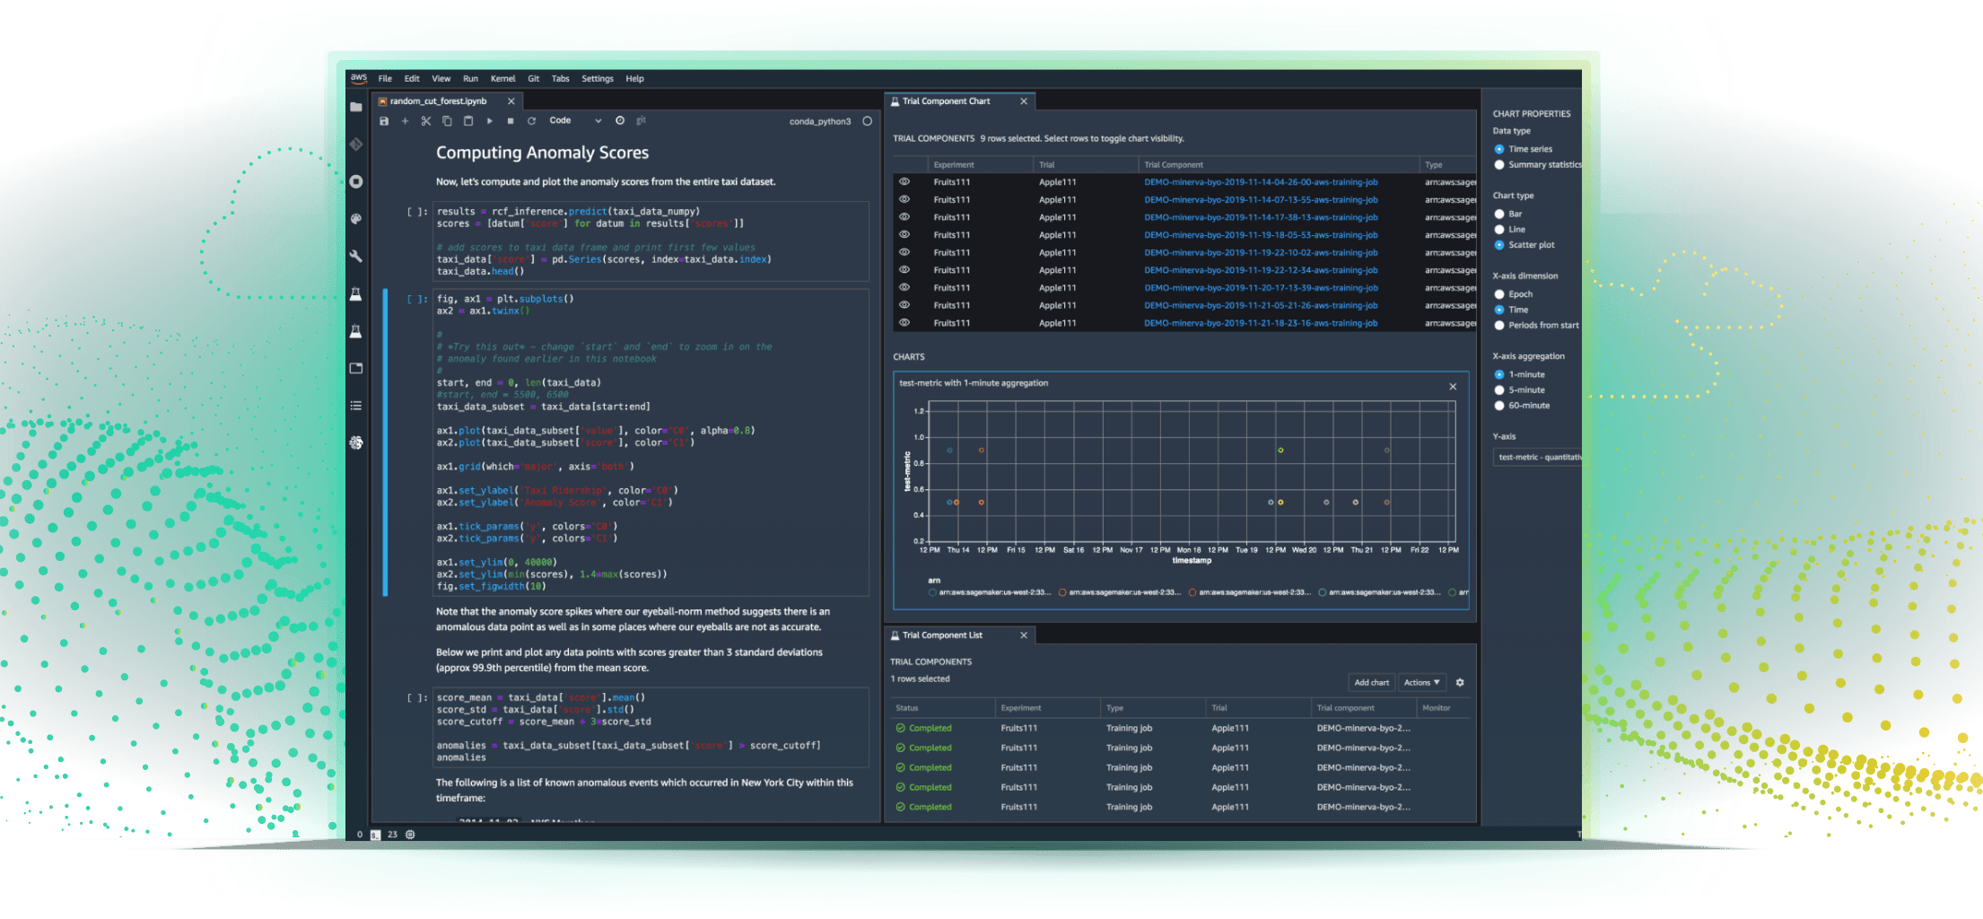
Amazon SageMaker
Most complete, end-to-end ML service
INTEGRATED WORKBENCH
IDE designed specifically for ML, data preparation, experiment management, and pipelines
MANAGED INFRASTRUCTURE
Designed for ultra low latency and high throughput; automatic scaling, and distributed training
https://aws.amazon.com/sagemaker
MANAGED TOOLING
Purpose-built from the ground up to work together incl. Autopilot, collaboration, notebooks, experiments, debugger, and model monitor
Notes:
Amazon SageMaker is the most complete, end-to-end service for machine learning. It is a managed service for data scientists and ML operations teams that helps remove the undifferentiated heavy lifting associated with machine learning, so that you in turn can have more time, resources and energy to focus on your business. SageMaker has a lot of features and a full workbench of capabilities, so I’m going to talk you through 4 main pillars that describe what SageMaker is, and how it gets used.
First off, SageMaker provides users with an integrated workbench of tools brought together in one place through SageMaker Studio. Users can launch Jupyter Notebooks and Jupyter Lab environments instantly through SageMaker Studio. SageMaker also provides complete experiment management, data preparation, and pipeline automation and orchestration to help make data scientists more productive.
Now, if you have used a Jupyter Notebook before, you know that it needs a computing environment to run on. SageMaker provides fully managed servers in the cloud to make this easy for data scientists and developers. But even beyond notebooks, SageMaker provides other managed infrastructure capabilities as well. From distributed training jobs, data processing jobs, and even model hosting, SageMaker takes care of all of the scaling, patching, high availability, etc. associated with building, training and hosting models.
There are tools within SageMaker that help make data scientists more productive. What you’ll see is that this integrated workbench, sitting on managed infrastructure, is also enriched by a huge ecosystem of tools, all purpose-built for ML and designed from the ground up to work together.

Slide 28
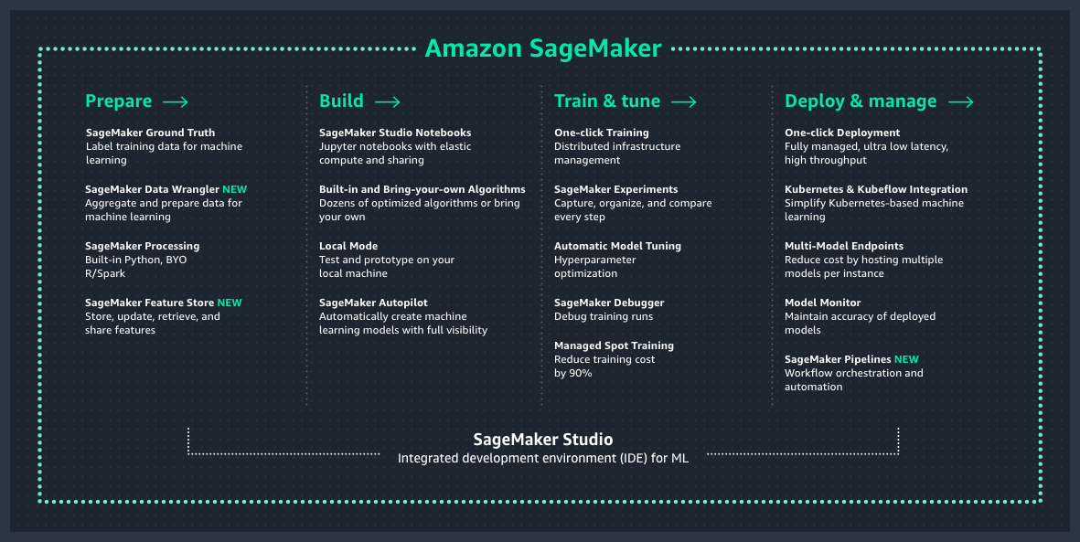
Amazon SageMaker overview
Notes:
As mentioned, SageMaker is a service with a lot of different features and capabilities in it. We typically talk about those capabilities as falling into four categories: Data preparation, the model build phase, training and tuning, and deployment and management (or hosting).
These four categories really address the needs that ML builders have when dealing with each stage of a model’s lifecycle.

Slide 29
Amazon SageMaker key benefits
ACCELERATE ML DEVELOPMENT
20+ tools covering the entire ML development lifecycle
BOOST DATA SCIENTIST PRODUCTIVITY
The world’s first integrated development environment (IDE)
The most complete, end-to-end ML service
REDUCE COST
Eliminate costs of writing custom integration code with integrated functionality optimized for ML
Notes:
Amazon SageMaker is the most complete end-to-end ML service helping our customer through improved agility, productivity, and cost-effectiveness.
Agility: Accelerate ML development with 20+ purpose-built tools ranging from Amazon SageMaker Data Wrangler for data preparation to SageMaker Pipelines for workflows, covering the entire ML development lifecycle.
Productivity: Boost your productivity using Amazon SageMaker Studio, the first IDE designed specifically for ML that brings everything you need for ML under one unified, visual interface.
Cost-effectiveness: Eliminate costs of writing custom integration code by leveraging tightly integrated Amazon SageMaker capabilities for data preparation, debugging, training, deployment, and model monitoring.

Slide 30
Amazon SageMaker
SECURITY
Security features to help you meet strict security requirements of ML workloads
COMPLIANCE
PCI, HIPAA, SOC 1/2/3, FedRAMP, and ISO 9001/27001/27017/27018
is devops ready
ML WORKFLOWS
Create automated workflows in minutes to support thousands of models
SCALABILITY
Train complex models with massive datasets
ORCHESTRATION
Automatic scheduling and execution of jobs with managed infrastructure
Notes:
Amazon SageMaker provides robust IT Ops features across security, workflows, scalability, and orchestration.

Slide 31

Table of contents
Amazon SageMaker Studio
Amazon SageMaker Autopilot Amazon SageMaker JumpStart
Amazon SageMaker Pipelines
Amazon SageMaker Clarify
PREPARE DATA
Amazon SageMaker Ground Truth
Amazon SageMaker Processing
Amazon SageMaker Data Wrangler
Amazon SageMaker Feature Store
TRAIN
Managed Training
Amazon SageMaker Experiments
Amazon SageMaker distributed training libraries
Amazon SageMaker Debugger
DEPLOY
Managed Deployment
Amazon SageMaker Edge Manager
OTHER
Kubernetes integration
Security
Human reviews
AWS Marketplace for machine learning

Slide 32

The NFL needed a solution for real-time stats
PROBLEM
3+ terabytes data, 1,500+ hours play time per week
Needed a solution for real-time stats
Lean team, no data science expertise
SOLUTION: NEXT GEN STATS
Engaged with ML Solutions Lab
Live data streamed to AWS from RFID tags on players and in game ball
Data processed in 100+ steps in under 1 second
ML models built on Amazon SageMaker make predictions in real time
IMPACT
Launched 20+ stats quickly with limited data science team
Sports announcers get interesting data points to engage fans
Notes:
Company background:
The National Football League (NFL) has 180 million fans worldwide. About 17 million of those trek out to stadiums each season—which means over 90% of NFL fans are catching the games on TV, online, and mobile. That's why NFL games represented 37 of the top 50 highest-rated television broadcasts of 2017.
Challenge:
The NFL has been keeping game statistics since 1920, and has been showing standard stats for the past several decades such as yards passing, yards rushing, catches, tackles, quarterback sacks, and interceptions. But these stats represent only a tiny fraction of the 2 terabytes of data the league collects every week from 1,500+ hours of play time. They saw the potential to use this data to provide new live predictive stats such as the probability of a pass completion. This required a machine learning solution that can analyze vast amounts of data and make predictions in real time.
Solution:
The NFL teamed up with AWS to transform how football is analyzed, played, coached, and experienced by fans, broadcasters, coaches, and teams. Through RFID tags attached to the players’ shoulder pads and embedded in the game ball, the NFL collects large volumes of tracking data like location, speed, acceleration, and distance traveled, charting individual movements within inches. In 2016, the NFL began working with AWS to leverage their expertise and to accelerate the Next Gen Stats (NGS) program to combine old and new data to provide players and fans with predictive stats about the game in real time. An example stat is the Completion Probability, which is the likelihood of a pass being completed. It’s predicted based on numerous factors, including the receiver’s separation from the nearest defender, the receiver’s location on the field, and the separation of the passer at the time of the throw from the nearest pass rusher.
In partnership with AWS Professional Services, the Next Gen Stats team created and deployed machine learning models using SageMaker. These models leverage inputs from traditional statistics, player tracking data, and player profiles. The models are continuously refined by the Next Gen Stats team to reflect trends and outcomes during any given season. Once deployed, the machine learning models provide real-time inference during games. To obtain real-time insights, data from the stadiums is streamed to AWS. Once in AWS, the data undergoes over a hundred processing steps in under a second.
As a result of this solution, the NFL is able to produce APIs, create on-screen graphics, give sports announcers unique data points to talk about, and expand their media and team tools.
The NFL is also working with AWS machine learning to create the Digital Athlete platform, which will improve player safety, treatment, and ultimately predict and prevent injury. The platform will use a computer simulation model of an NFL player that combines numerous data sources, including NGS data, to help the NFL test different scenarios without risk to athletes. The NFL plans to use machine learning to reduce injuries – leveraging data to understand how head injuries occur, how they can prevent them, and how to design better equipment and rules.
Link: https://blog.aboutamazon.com/amazon-ai/partnering-with-the-nfl-to-transform-player-health-and-safety
Why SageMaker?
The Next Gen Stats team is lean with just a handful of engineers, who are trained mainly in software development, but not as much in data science. SageMaker’s built-in algorithms and Jupyter Notebook instances allowed the small team to build and publish 20+ stats quickly without having to hire teams of data scientists.
NFL business outcomes:
Using SageMaker to build, train and run these predictive models helped reduce the time to get to insights from as much as 12 hours to 30 minutes. These insights help fans understand why some passing plays are more difficult than others and provide more meaningful understanding of the game itself. Additionally, these insights can be used by the NFL and its media partners quickly to enhance broadcasts and online content, as well as educate and engage fans inside the stadium. With SageMaker, the NFL didn’t need to hire teams of data scientists to accomplish all this, and could get up and running right away.
MORE INFO:
https://aws.amazon.com/nextgenstats/

Slide 33
Next Gen Stats solution architecture
NGS Processors
Stadium
Tracking data
Apache Kafka
Data distributors
Stats FTP
Traditional stats
NGS Processors
ML Processors
Websites
SageMaker
NGS API
Club Tools
Entire solution runs on AWS
Amazon SageMaker lets ML models deployed into existing analytics pipelines
Streaming data architecture with Apache Kafka
Notes:
SageMaker provided the team the flexibility to continue to use their existing architecture consisting of open-source tools such as Apache Kafka. With SageMaker, they were able to deploy machine learning models into their existing analytics pipeline without significant changes to the architecture.

Slide 34

Thomson Reuters wanted to enable ML at scale
PROBLEM
Thomson Reuters wanted to enable ML at scale
Data scientists needed secure access to data, while ensuring compliance with Thomson Reuters enterprise security policies
SOLUTION: SECURE CONTENT WORKSPACES
SCW provides access to data in compliance with internal security standards
Amazon SageMaker, enabled through SCW, provides a fully managed machine learning environment
IMPACT
Secure experimentation at scale in compliance with TR policies
Intelligent and timely solutions for their customers
Notes:
Challenge:
To enable this customer-centric structure, Thomson Reuters began a migration project in 2018 to exit 7-9 strategic data centers, and move their data into AWS. During this time, Thomson Reuter’s data scientists started testing Amazon SageMaker across different business units. Most of these efforts happened in silos, causing technical issues that consumed significant time and resources.
Solution:
In early 2019, Thomson Reuters built an internal platform, Secure Content Workspaces (SCW), to enable data scientists and developers across the company to access data in compliance with the company’s security standards. Using SCW with Amazon SageMaker, they were able to eliminate the need for data scientists to deal with data access permissions, network security, user roles, containers, and other challenges associated with building, training, and managing ML models. This allowed the data scientists to focus on their core competencies of data science and analytics instead of managing infrastructure, networking, and data pipelines.
Why SageMaker?
Since 2018, AWS has been the preferred cloud provider at Thomson Reuters with the goal to completely migrate from their on-premises data centers to AWS. As they migrated their data to AWS, their data scientists found it easy to use SageMaker to securely and readily access large amounts of data for their ML projects. As a result, Data scientists can experiment at scale with security and compliance with TR policies. Frictionless access to cloud computing resources ensures intelligent & timely solutions for their customers

Slide 35




Thomson Reuters solution architecture
SCW with Amazon SageMaker allows ready data access to data with right permissions, security, user roles, etc.
Fully managed access to compute options: CPU, GPU, Spot instances
TR Content Owner
Grants access to TR content
Scientist
Writes modesls
Scientist’s Secure Storage
Reads models
Creates workspace and services
Requests access to TR data
Provisions Notebook Environment
Managed Spot Training
Scientist’s Secure Storage
Amazon SageMaker
Model Building
GPU
Amazon SageMaker
Hosting
Provisions
GPU
Amazon SageMaker
Training
GPU
TR Content
Grants
Github Enterprise
Launches
(Start, Stop, open)
Data science discovery
Interactive model building
Launches, training at scale
SageMaker Notebook Environment
Provisions
Notes:
In early 2019, Thomson Reuters built an internal platform, Secure Content Workspaces (SCW), to enable data scientists and developers across the company to access data in compliance with the company’s security standards.
Using SCW with Amazon SageMaker, they were able to eliminate the need for data scientists to deal with data access permissions, network security, user roles, containers, and other challenges associated with building, training, and managing ML models. This allowed the data scientists to focus on their core competencies of data science and analytics instead of managing infrastructure, networking, and data pipelines.

Slide 36

Gartner Solution Scorecard for Amazon SageMaker, July 2020
SageMaker has an overall score of 84/100, the highest rating among its peer group—according to Gartner, SageMaker met 87% of Gartner’s required criteria, 73% of preferred, and 85% of optional—Gartner subscribers can click here to learn more
Notes:
Gartner has released its 2020 Solution Scorecard for Amazon SageMaker (available for Gartner clients here). Gartner subscribers can click here to learn more about why we have an Overall Score of 84/100, the highest rating among our peer group. According to Gartner, we met 87% of Gartner’s required criteria, 73% of preferred, and 85% of optional in the Gartner “Solution Scorecard for Amazon SageMaker, July 2020."

Slide 37


Lyft, one of the largest transportation networks in the United States and Canada, launched its Level 5 autonomous vehicle (AV) division in 2017 to develop a self-driving system to help millions of riders.
Using Amazon SageMaker distributed training, we reduced our model training time from days to couple of hours. By standardizing machine learning workloads on AWS, we streamlined our development cycles and reduced costs, ultimately accelerating our mission to deliver self-driving capabilities to our customers.”
Alex Bain,
Lead for ML Systems at Lyft Level 5
Notes:
One company that I want to spend just a moment touching upon, is Lyft.
Lyft, one of the largest transportation networks in the United States and Canada, launched its Level 5 autonomous vehicle (AV) division in 2017 to develop a self-driving system to help millions of riders. Lyft Level 5 aggregates 10+ terabytes of data a day to train machine learning models for their fleet of autonomous vehicles.
Managing machine learning workloads on their own was becoming time-consuming and expensive.
And, as one of their ML Systems Leads said best, I’ll just quote him directly: “Using Amazon SageMaker distributed training, we reduced our model training time from days to couple of hours. By standardizing machine learning workloads on AWS, we streamlined our development cycles and reduced costs, ultimately accelerating our mission to deliver self-driving capabilities to our customers.”

Slide 38
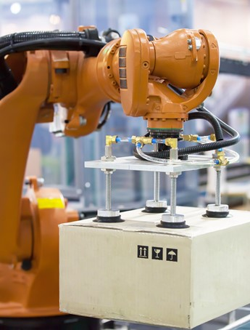





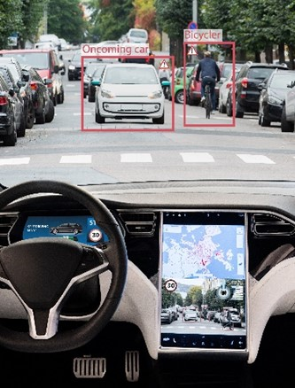


SageMaker Common use cases
Predictive Maintenance
Manufacturing, Automotive, IoT
Demand Forecasting
Retail, Consumer Goods, Manufacturing
Fraud Detection
Financial Services, Online Retail
Credit Risk Prediction
Financial Services, Retail
Extract and Analyze Data from Documents
Healthcare, Legal, Media/Ent, Education
Computer Vision
Healthcare, Pharma, Manufacturing
Autonomous Driving
Automotive, Transportation
Personalized Recommendations
Media & Entertainment, Retail, Education
Churn Prediction
Retail, Education, Software & Internet
Notes:
Transition: So, Lyft is using SageMaker for distributed training; The NFL is using SageMaker for hosting models to provide better business intelligence to their franchises; Arlo is using SageMaker for low latency inference. Those are just three of literally hundreds of use cases that we commonly see companies using SageMaker for. Amazon SageMaker is a general-purpose machine learning service that you can use to build, train, and deploy ML models for virtually any use case. But what you see here are some of the more common ones.
1/ Predictive Maintenance
Georgia Pacific uses SageMaker to develop ML models that detect machine issues early. Get started with SageMaker solutions: Predictive maintenance for industrial equipment | Predictive maintenance for vehicle fleet.
2/ Demand Forecasting
Advanced Microgrid Solutions uses SageMaker to forecast energy prices in near real time. Get started with the SageMaker solution: Deep demand forecast.
3/ Fraud Detection
Euler Hermes uses SageMaker to catch suspicious domains. Get started with SageMaker solutions: Fraud detection using transactional data | Fraud detection using graph neural networks (GNN).
4/ Credit Risk Prediction
Fannie Mae utilizes SageMaker to develop, evaluate, expand, and improve the models used in everything from assessing the loans it backs to analysis of property values. Get started with the SageMaker solution: Explaining credit decisions with Amazon SageMaker.
5/ Extract and Analyze Data from Documents
Thomson Reuters uses SageMaker to create natural language processing capabilities that power their question answering applications. Get started with this workshop.
6/ Computer Vision
3M is using defect detection models built on SageMaker to improve the effectiveness of its quality control processes and move beyond time-consuming manual inspection. Get started with this workshop.
7/ Autonomous Driving
Lyft Level 5 standardized on SageMaker for training and reduced model training times from days to under a couple of hours. Get started with this blog post.
8/ Personalized Recommendations
iHeartRadio uses SageMaker to recommend music in real-time to new subscribers. Get started with this blog post.
9/ Churn Prediction
Boostability uses machine learning on SageMaker to help keep customers engaged. Get started with this example.
===== Interaction Opportunity =====
Can I pause here to learn more about what use cases you are considering using SageMaker for?

Slide 39
The AWS ML stack Broadest and most complete set of machine learning capabilities
Vision
Chatbots
Business tools
Search
Healthcare
Rekognition
Lex
Personalize Forecast Fraud Detector
Lookout for Metrics
Kendra
HealthLake
Comprehend Medical
Transcribe Medical
AI SERVICES
Speech
Text
Contact centers
Code + DevOps
Industrial
Polly Transcribe
Comprehend Translate Textract
Contact Lens Connect Voice ID
CodeGuru DevOps Guru
Panorama Appliance and SDK, Monitron, Lookout for Equipment, Lookout for Vision
SAGEMAKER STUDIO IDE
Label data
Data collection prep
Store features
Detect bias and explain predictions
Visualize in notebooks
Pick algorithm
Train models faster
Tune parameters
Deploy in production
Manage & monitor
Manage edge devices
AMAZON SAGEMAKER
CI/CD
ML FRAMEWORKS & INFRASTRUCTURE
TensorFlow, PyTorch, Apache MXNet
Deep learning AMIs & containers
GPUs
Inferentia
Elastic inference
FPGA
Notes:
Now, at the top of the stack, we serve developers and companies who want to add solution-oriented intelligence to their applications through an API call rather than developing and training their own models in SageMaker. And we have a lot of services in this area to address your needs, including industry specific services.
Industrial AI services are designed to help our customers in manufacturing, agriculture, energy, or other heavy industries. Amazon HealthLake is specifically made for our health care and life sciences customers.
Vision (Rek Image and video) “tell me what’s in this image,” “which celebrities are in this image,” and, “is this image safe for work?”
Speech – (Polly, Transcribe) – If you want to turn text into speech we have Polly, and if you want to transcribe audio we have Transcribe
Text (translate, comprehend, textract) – If you want to translate text to different languages we have translate, and if you want to understand what’s being said in those translated corpuses of text you have Comprehend, if you want to extract text from documents using OCR++, you have Textract.
Then you have the things which Amazon is relatively famous for. Alexa and chatbots with Lex, personalization, and forecasting
Customers have asked us to continue to consider adding services around areas where we have a lot of experience and data from our consumer business…
Amazon Fraud Detector, a new fraud management service for detecting online identify and payment fraud in real-time. No machine learning experience required.
Amazon CodeGuru, a new machine learning service to automate code reviews and identify your most expensive line of code. And we launched Amazon DevOps Guru, which helps identify application errors and fixes
Contact Lens for Amazon Connect provides machine learning powered contact center analytics for Amazon Connect. And Voice ID, machine learning-based caller authentication.
Amazon Kendra, a new service which reinvents enterprise search with machine learning.
We also recently announced a suite of services for industrial sectors including computer vision at the edge, predictive maintenance, and automated visual inspection.
Let’s talk through some examples.

Slide 40



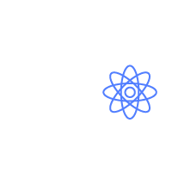



Customer challenges with building NLP models
Data annotation
Machine learning skills
Labeled training data
Model training effort
Model management in production
Data collection and preparation
Training language models
NLP model
Notes:
There are a number of NLP tools available to customers. These tools can perform NLP functions such as identify entities, classify documents, and extract parts of speech from sentences. Even if open source or free, these tools or solutions come at a cost. In most cases, users need to know machine learning to be able to understand how the tools work.
First, they need to know what kind of training data they need to be able to train their own NLP models.
Then they need to collect data to train models. When training models from scratch, they need to collect thousands of examples to train models. Most customers find this step challenging as the quality of training data decides the accuracy of trained models.
Training models is not a single step process. Customers need to run multiple iterations, tweaking training data, modifying models, identifying algorithms that are more accurate for their data in each step. Again, each of these steps requires them to know machine learning.
Finally, when they have models in production, they need to ensure they continue to be relevant and accurate. As data changes, models tend to drift. Detecting sentiment in text becomes challenging as people derive new ways and choice of words to express their emotions. Organizations need to continuously collect new data and feed it into their models on a regular basis.
For business users and developers who are not data scientists, using NLP can become a daunting task. However, most of the use cases that need NLP do not need customers to build their own NLP models from scratch. They can use models that are pre-trained for their use cases and that offer simple API interfaces to use NLP. Amazon Comprehend does just that.

Slide 41

Amazon Comprehend
A fully managed and continuously trained service that discovers insights and relationships in text.
Notes:
Amazon Comprehend is a fully managed and continuously trained service that discovers insights and relationships in text using machine learning. Launched in 2017, Amazon Comprehend provides simple APIs that any developer can use to process text in many languages including English, French, Japanese, Chinese (simplified and traditional) and more.

Slide 42


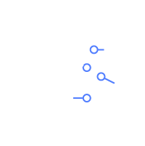






Amazon Comprehend
Discover insights and relationships in text
Entities
Key Phrases
PII
(Personally Identifiable Information)
Sentiment
Document Classification
Amazon
Comprehend
Automatically extract insights from text
Topics
Documents
Email, chat, social, phone calls and more
Language
Syntax
Events
Notes:
Amazon Comprehend has pre-trained models that identify entities such as places, people, brands, or events; determine the language of the text; extract key phrases; understand how positive or negative the sentiment of text is; and automatically organize a collection of text files by topic.
However, customers have data that contains text that is very specific to their organization or business. They could have specific product names or document types. Therefore customers can train Comprehend to extract customer-specific entities or to assign specific labels to documents.
Vision Critical provides a customer relationship intelligence software that enable large enterprises to be fast, responsive, and customer-centric. By integrating with Amazon Comprehend’s sentiment analysis, their platform turns qualitative customer feedback into actionable insight, determining whether their feedback is positive, negative, or neutral at over 90% accuracy.
LexisNexis uses Comprehend’s custom entities recognition models to discover insights from legal documents. Entities such as judge and attorney, can be identified quickly from over 200 million documents at above 92% accuracy.

Slide 43








Typical Amazon Comprehend use cases
Automation of email workflows
Customer sentiment analysis
Customer support tickets routing
Contact center call analysis
Personally Identifiable Information (PII) detection and redaction
Documents and media tagging
Intelligent document processing

Slide 44


Accelerating investigation timelines
FINRA uses Amazon Comprehend to process and review millions of documents with unstructured data, helping flag records of interest that should be reviewed by human investigators.
Notes:
FINRA is a not-for-profit organization authorized by Congress to protect America’s investors by making sure the broker-dealer industry operates fairly and honestly.
FINRA receives millions of documents with unstructured data to support investigative, examination, and compliance processes. Previously, investigators and examiners had to manually go through documents page by page to find what they needed.
FINRA uses Amazon Comprehend to quickly extract names of individuals and organizations, and match extracted entities to FINRA records, flag individual of interest, generate summaries, and detect similarities with other documents.
This exponentially increases the scope of investigations while shortening the time to conclusion.

Slide 45

Personalizing the customer experience
Best Western uses Amazon Transcribe and Amazon Comprehend to convert speech to text and uncover insights to deliver more personalized customer experiences for guests.
Notes:
Best Western
The hotel brand is planning to use Amazon Connect, a cloud-based contact center service, to better serve customers around the globe who need booking support, along with AWS machine learning services, such as Amazon Transcribe and Amazon Comprehend, to convert speech to text and uncover insights to deliver more personalized customer experiences for guests.
Working with AWS, Best Western Hotels & Resorts is identifying additional ways to use analytics and machine learning services across its entire business. For example, they plan to use Amazon SageMaker, a fully managed service to build, train, and deploy ML models, and Amazon Forecast, a fully managed service that uses machine learning to deliver highly accurate forecasts, to uncover key trends and guest booking patterns in order to offer more personalized recommendations to the nearly 40 million members of its Best Western Rewards® loyalty program.
#AMER
https://press.aboutamazon.com/news-releases/news-release-details/best-western-hotels-and-resorts-go-all-aws

Slide 46


Amazon Rekognition
Deep learning-based image and video analysis
Amazon Rekognition is a service that can identify objects, people, text, scenes, and activities in images and videos.
Notes:
So what is Amazon Rekognition?
Amazon Rekognition makes it easy to add image and video analysis to your applications using proven, highly scalable, deep learning technology that requires no machine learning expertise to use. With Amazon Rekognition, you can identify objects, people, text, scenes, and activities in images and videos, as well as detect any inappropriate content. Amazon Rekognition also provides highly accurate facial analysis and facial search capabilities that you can use to detect, analyze, and compare faces for a wide variety of user verification, people counting, and public safety use cases.
For face-based authentication, Amazon Rekognition provides a number of different APIs that can support KYC workflows, including Face Search, Face Comparison, Face Analysis, and Text Detection. In turn, leading customers across FinServ, Retail, Travel, Hospitality, etc. adopted Rekognition for their face-based ID verification needs.

Slide 47

Facial analysis
Demographic data
Emotion expressed
Age range:
Gender: Male
29-45
96.5%
Happy
Surprised
83.8%
0.65%
Facial landmarks
General attributes
EyeLeft, EyeRight, Nose, RightPupil, LeftPupil, MouthRight, LeftEyeBrowUp
Bounding Box...
Smile: True
Eyes Open: True
23.6%
99.8%
Facial pose
Image quality
Pitch
Roll
Yaw
1.446
5.725
4.383
Brightness
Sharpness
23.6%
99.9%
Notes:
What is Facial Analysis?
Facial analysis is the process of detecting a face within an image and extracting relevant face attributes from it. Amazon Rekognition Image takes an image and returns the bounding box for each face detected in an image along with attributes such as gender, presence of sunglasses, and other face landmark points.
Rekognition Video will return the faces detected in a video with timestamps and, for each detected face, the position and a bounding box along with face landmark points.

Slide 48




Face comparison
Measure the likelihood that faces are of the same person
Similarity 93%
Similarity 0%
Notes:
What is Face Comparison?
Face Comparison is the process of comparing one face to one or more faces to measure similarity. Using the CompareFaces API, Amazon Rekognition Image lets you measure the likelihood that faces in two images are of the same person. The API compares a face in the source input image with each face detected in the target input image and returns a similarity score for each comparison. You also get a bounding box and confidence score for each face detected. You can use face comparison to verify a person’s identity against their personnel photo on file in near real-time.

Slide 49

Text detection
Extract text content from real-world images and videos in various layouts, fonts, and styles
Notes:
Amazon Rekognition also has text detection capabilities and can detect and extract text in images and videos. For example, it can extract the text off the driver’s license – things like the person’s name, address, license ID, and birthdate

Slide 50




Identify verification using Amazon Rekognition
Upload image of ID to S3
Similarity score
S3 stores the image of the ID and the image of the user
Amazon Rekognition compares the image of the ID with the image of the user
Amazon Rekognition provides a similarity score which measures the likelihood that the faces of two images are of the same person
Upload picture of user to S3
Notes:
One of the common implementations of Amazon Rekognition, particularly within the emerging markets space is the targeted use case of identity verification where a person would take a picture of their government ID, such as a driver’s license or passport, and then take a picture of him/herself – upload both pictures and Amazon Rekognition will provide a similarity score that measures the probability or likelihood that the faces of the two images are of the same person.
[Note to speaker: You can reference the Aella Credit and CreditVidya customer stories to follow this slide as examples.]

Slide 51


Face search
Recognize a person in a photo or video using your private repository of face images
Index
Collection
Search
Notes:
While the previous example was a very targeted use case of comparing just two images, Amazon Rekognition can also be leveraged such that instead of comparing the picture of yourself with just one reference image like your driver’s license, you can also compare it against a collection of reference images.
And now, you can apply this solution to a entirely new set of use cases

Slide 52


Face matching using Amazon Rekognition
Collection of reference images stored in S3
Similarity score
Upload image of user to S3
S3 stores the image of the user
Amazon Rekognition compares the image of the user with the collection of reference images
Amazon Rekognition provides a similarity score which measures the likelihood that the faces of two images are of the same person
Notes:
Using the same flow as before, upload a picture of yourself, and this picture would be compared across a collection of images.
One example where we’ve seen customers use this is at ATM machines to provide an extra layer of authentication. Another example is a payment solution where an individual can pay for a retail transaction simply by looking at a camera.
[Note to speaker: You can reference the PrivatBank customer story to follow this slide as an example.]

Slide 53
Automating payments with biometrics
PrivatBank, the largest commercial bank in Ukraine, launched a biometric payment system called FacePay24, which uses Amazon Rekognition to allow users to pay for purchases by looking at a tablet’s camera.
Notes:
PrivatBank and Visa payment system announced the launch of FacePay24 biometric payment system in Ukraine, which will operate in the retail network. The first Ukrainian outlets where buyers can pay for products with “face” are four stores of the national HOP HEY network in Dnipro. FacePay24 uses one of the world's leading automatic face recognition - Amazon Rekognition technology, and enables scaling of this service to almost to any outlet.
To use the face-to-face payment service, you must install the updated Privat24 app on your smartphone and activate FacePay24 payment. Then, following the tips of the program, you need to take three Selfies from different angles and attach a Visa bank card to your face. You can then pay for your purchases by looking at the tablet's special camera near the cash desk.
Link: https://en.privatbank.ua/news/2019/9/12/1011

Slide 54

Automating document
classification
WeLend, a social lending platform based in Hong Kong, uses Amazon Rekognition to identify and categorize various documents uploaded to their application, such as a driver’s license or ID card. This information is used to analyze an applicant’s risk profile as well as verify personal details and prevent fraud.
Notes:
In 2013, WeLab launched WeLend, an online lender providing unsecured loans to individuals. WeLend has a lean operations model with no physical branches or manual processes—everything from filling out of forms to in-person interviews is done online. Unlike banks, which rely on traditional data such as credit scores, WeLend uses a multitude of data points, such as social media and mobile data, to make credit decisions in minutes.
Its proprietary artificial intelligence (AI)–based credit-decisioning engine, WeDefend, allows the company to service riskier applicants: those who cannot get a bank loan due to a lack of credit history or poor credit score. “We leverage data from the credit bureau in Hong Kong as well as behavioral data, sources from mobile phones to other devices, and social media. We conglomerate all of that big data to get a more holistic understanding of the customer risk profile,” says Joyce Wong, growth analyst at WeLend.
WeDefend is the company’s crown jewel. It is not only used to analyze an applicant’s risk profile, but it is also used to verify personal details and prevent fraud. The WeDefend algorithm runs on Amazon Elastic Compute Cloud (Amazon EC2) instances, where big data is processed, and then stored in Amazon Simple Storage Service (Amazon S3) buckets. The startup also utilizes Amazon’s AI tools, such as Amazon Rekognition, to identify the category of each document uploaded to the app, such as a driver’s license or ID card.
Link: https://aws.amazon.com/solutions/case-studies/WeLend/

Slide 55
More relevant enterprise search with Amazon Kendra
DOMAIN
EXPERTISE
20+ NATIVE CONNECTORS
ML-OPTIMIZED INDEX
SIMPLE API TO INTEGRATE SEARCH
NATURAL LANGUAGE
SEARCH
INCREMENTAL
LEARNING THROUGH
FEEDBACK
Eliminate information silos
Simplify and accelerate integration
Find more precise answers
Easily develop search applications
Contextual search results
Up-to-date relevant answers
Notes:
Enterprise search which today has multiple silos of unstructured data and it’s difficult and time consuming to find answers.
Keyword searches are unintuitive and error prone so workers have to learn keyword combinations instead of relying on natural language.
Amazon Kendra makes enterprise search easier by providing deeper content analysis via ML and NLU to find precise and personalized answers to queries.
For example, when you’re laptop is broken, rather than having to remember the exact keyword to search, you can simply ask, “where can I repair my laptop”.
Connects with S3, RDS, Sharepoint, File System, Web Servers, Dropbox, Box, OneDrive, etc.
Kendra improves over time, allows customers to load and manage FAQs to deliver highly tuned ML-based search for precise responses to end users

Slide 56
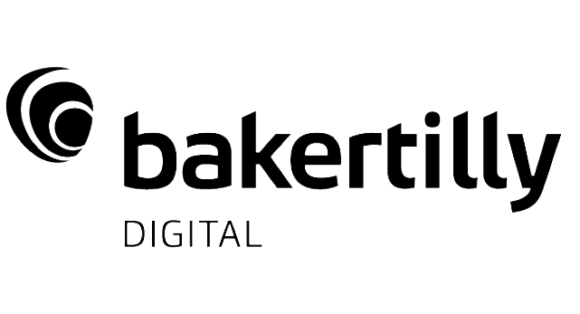
Making better and faster decisions on the job
"Baker Tilly is excited about the impact Kendra will have on our client’s ability to make key decisions through data by providing access to repositories of knowledge in one quick, easy and accurate service."
Ollie East, Director of Advanced Analytics and Data Engineering, Tom Puch, Sr. Manager, Baker Tilly Digital | Labs
Notes:
“Baker Tilly is a leading advisory, tax and assurance firm dedicated to building long-lasting relationships and helping customers with their most pressing problems — and enabling them to create new opportunities. Baker Tilly works with clients on rationalizing their data to provide insights on market conditions, customer preference and trends thus enabling them to quickly anticipate and adapt to change. Many organizations struggle to unlock the value of the vast repositories of structured and unstructured data they have accumulated over the years. By leveraging Amazon Kendra, Baker Tilly is able to help its clients connect the right people to key information held within their knowledge repositories. Amazon Kendra provides direct connection with unbelievable levels of efficiency and accuracy. We found that by using Kendra, our clients are able to surface relevant information 10 times faster when compared to SharePoint full text search. As an example, Amazon Kendra allows product managers to ask questions in everyday language such as “What parts are made of titanium?”, quickly surfacing an answer such as a list of relevant product manuals, technical bulletins, service alerts, and patent registrations previously not possible with keyword search and connecting them to relevant content across an enterprise-wide repository, or providing marketing managers quick access to crucial research on customer behavior.

Slide 57
Better insights lead to better customer service with Contact Lens for Amazon Connect
Transcribes live
and archived calls
Enhanced search
on call and chat
transcripts,
sentiment scores,
silence duration, etc.,
Custom categorization
to identify common
call types
Prioritized
list of recurring
issues based on
customer feedback
Real time
dashboard and
alerting for supervisors
Provide agents with answers to questions as they are being asked
Notes:
Lastly, we introduced Contact Lens for Amazon Connect, a fully-managed add-on that allows customers of Amazon Connect, our cloud contact center service
Use the power of ML without requiring any technical skills to do things such as identify common call types, identify recurring themes based on customer call feedback, alert supervisors when customers are having a poor experience, and assist agents with a knowledge base to answer questions as they are being asked.

Slide 58
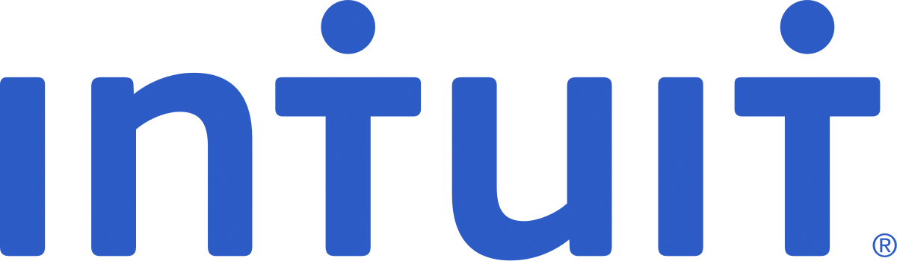
Address customer issues in real time
Intuit wanted to optimize its end-to-end live agent experience to ensure the best possible service for its customers
Using Contact Lens for Amazon Connect (powered by ML), Intuit is automating call categorization to monitor customer experience and regulatory compliance during calls
Notes:
Intuit wanted to optimize its end-to-end live agent experience to ensure the best possible service for its customers. Using Contact Lens for Amazon Connect (powered by ML), Intuit is automating call categorization to monitor customer experience and regulatory compliance during calls. “With Contact Lens for Amazon Connect, we’re able to quickly understand our customers’ needs, and use those insights to create new machine learning models and solutions that best serve our customers.” Ashok Srivastava, Chief Data Officer, Intuit

Slide 59
Identify fraud faster with Amazon Fraud Detector
Enhance fraud detection with ML
Any level of ML expertise can build ML fraud models
ML boost from Amazon experience, enrichments
Fewer false positives, manual reviews
Fraud staff self-service to address threats faster
Lower TCO, faster TTV
Notes:
Customers report a range of different benefits from the use of Amazon Fraud Detector which include:
Enhancing their fraud detection efforts with machine learning. Amazon Fraud Detector has been used by customers to augment or replace their existing rules-based fraud detection solution.
Enabling users with any level of machine learning expertise to build ML models. Amazon Fraud Detector enables customer fraud operations staff that are not ML experts to build and use ML-based fraud models so that fulltime data scientist involvement in fraud detection efforts is not needed or can be repurposed to address other organization needs.
Improving the results of their machine learning models with the enrichments and fraud detection experience of Amazon. Most customers report that the results of the model produced with Amazon Fraud Detector is better than what they had built for themselves.
Fewer false positive alerts and fewer overall manual reviews. Customers see a significant drop in the amount of work their customer service and fraud operations teams must process with models produced with Amazon Fraud Detector.
Allowing fraud operations teams to implement new measures to address threats. Fraud prevention teams use Amazon Fraud Detector to act on their own to instantly define and deploy new model logic to address new attacks and bypass the need to work with IT.
Lowering Total Cost of Ownership while speeding up Time To Value. Customers can log onto the AWS console and immediately start developing and deploying fraud detection solutions using Amazon Fraud Detector without upfront costs, commitments, or the need to install, configure, or maintain software.

Slide 60

Identify potentially fraudulent online activities
“GoDaddy is committed to preventing fraudulent accounts and we’re continually bolstering our capabilities to automatically detect such accounts during sign-up. We recently began using Amazon Fraud Detector and we’re pleased that it offers low cost of implementation and a self-service approach to building a machine learning model that is customized to our business. The model can be easily deployed and used in our new account process without impacting the signup experience for legitimate customers. The model we built with Amazon Fraud Detector is able to detect likely fraudulent sign-ups immediately, so we’re very pleased with the results and look forward to accomplishing more.”
John Kercheval, Senior Director, Identity Services Group at GoDaddy
Notes:
GoDaddy is an e-commerce vendor looking for a way to prevent fraudulent accounts by bolstering their fraud detection capabilities during account sign-up. They liked that Amazon Fraud Detector offered a self-service approach to building and deploying a machine learning model customized to their business as well as a low cost of implementation. The model can detect likely fraudulent accounts at the time of account signup without impacting the signup experience for their legitimate customers.

Slide 61

Amazon CodeGuru to build and run high-performing software
WRITE + REVIEW
Built-in code reviews with intelligent recommendations
BUILD + TEST
Detect and optimize the expensive lines of code pre-prod
DEPLOY
MEASURE
Easily identify application inefficiencies in production environment
IMPROVE
Notes:
Another area that we’re making easier with ML is the DevOps work flow.
Today’s DevOps workflow still requires lots of human interaction from expensive and hard to find resources with long implementation cycles required.
Manual analysis of large amounts of data is time consuming.
And the impact is serious when lack of early code reviews leads to outages or customer issues.
Amazon CodeGuru starts to address this by proactively recommending how to remediate issues across source code on running applications.
It is the first fully managed service that helps proactively improve code quality and optimize performance.
CodeGuru leverages machine learning models and best practices informed by years of experience and data from Amazon.com and AWS to find wide ranging issues in source code such as use of un-sanitized inputs, inappropriate handling of sensitive data, thread safety issues, and deviation from AWS best practices.
CodeGuru includes:
Automated code reviews with intelligent recommendations that even junior staff can follow
Code reviews seamlessly integrate with pull request workflow or performed anytime on-demand
Detection and optimization of the most expensive line of code
Immediate identification of application inefficiencies running in a production

Slide 62

Less time
investigating problems, more time innovating
Atlassian has reduced the investigation time for anomalies from days to hours and sometimes minutes using CodeGuru’s continuous profiling feature and by adopting CodeGuru Reviewer.
Notes:
When we detect anomalies in production, we have been able to reduce the investigation time from days to hours and sometimes minutes thanks to AWS CodeGuru’s continuous profiling feature. Our developers now focus more of their energy on delivering differentiated capabilities and less time investigating problems in our production environment.” - Zak Islam, Head of Engineering, Tech Teams, Atlassian

Slide 63
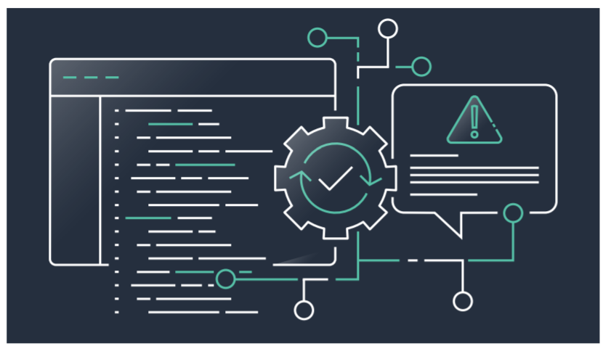
Amazon DevOps Guru ML-powered cloud operations service to improve application availability
DevOps Guru is an ML-powered service that makes it easy for developers and operators to automatically detect issues to improve application availability and reduce expensive downtime—no machine learning experience required.
Notes:
This need to reduce the noise, bring to surface critical issues with relevant data and help identify the cause quickly to reduce MTTR is what Amazon DevOps Guru seeks to deliver.
Amazon DevOps Guru is a fully-managed ML powered service that monitors applications to automatically improve availability and prevent downtime.

Slide 64
Delight your customers and improve customer experience with Amazon Personalize
Deliver high quality recommendations
Adapt to changes in customer intent in real time
Train a recommendation model with a few clicks
Generate recommendations for almost any product or content
Notes:
With Personalize we aim to give you out of the box solution to foundational use cases for personalization. You can use these capabilities for generating a broad array of Personalized user experiences

Slide 65

Improving the quality of recommendations
Compared to the prior approach, Amazon Personalize eliminated the need for tedious and complex manual data analysis, and reduced development time by 50%
Notes:
Lotte Mart is a subsidiary of Lotte Conglomerate, the leading retail company in Korea. It operates Hypermarket, Members-only warehouse discount outlet, electronics digital shop, and toysRus store in Korea. It has 187 stores in Korea, Indonesia and Vietnam earning $6.3B in 2018.
The company believes deeply in the power of AI/ML to strengthen business performance, and selected AWS to support its forays into the space as it embarks on a broad rollout of cutting-edge technology. In an effort to deepen its engagement with in-store shoppers, Lotte Mart launched a new AI-based recommendation service built on Amazon Personalize, which represents a departure from their prior approach of providing personalized recommendations through their mobile app M Coupon that they based on big data analytics.
The company decided to adopt Amazon Personalize to significantly improve the quality of its recommendations, and indeed, during a trial of Amazon Personalize with 100,000 customers held from July to August, Lotte Mart discovered customers were 2x as likely to purchase recommended products. It also reduced development time by 50%.
Now, over 300,000 users of M Coupon will get to benefit from improved recommendations and a personalized shopping experience, from which Lotte Mart expects to see tremendous positive revenue impacts.
#APAC
#Personalize

Slide 66





Industrial AI AI and ML services for asset-intensive industry use cases
AWS Panorama Appliance
Hardware appliance to add computer vision to existing onsite cameras
AWS Panorama Device SDK
Build new cameras and devices that run computer vision applications at the edge
Amazon Monitron
End-to-end system for equipment monitoring to detect abnormal machine behavior and enable predictive maintenance
Amazon Lookout for Equipment
Detect abnormal machine behavior using existing industrial sensor data
Amazon Lookout for Vision
Spot defects and anomalies in manufacturing using computer vision
Notes:
For customers in manufacturing, agriculture, energy, or other heavy industries, we are providing a group of services which will help improve operating efficiency, throughput, and reduce costs in industrial processes.
For processes or locations which have intermittent, expensive, or non-existent connectivity – or which can’t afford a round trip to the cloud in terms of latency – we’re enabling customers to add computer vision to their processes with smart cameras through the Panorama Device SDK – a thin, low power SDK which will optimize and run sophisticated computer vision models with low latency, on low power, cheap cameras.
For customers who already have dumb cameras installed on site, we are also adding the AWS Panorama Appliance, a powerful edge processing device, custom-built for computer vision.
For equipment which doesn’t already include sensors – or for organizations that want to perform predictive maintenance without a big investment in engineering time – we are also providing Amazon Monitron, an end to end predictive monitoring solution, which includes wireless hardware temperature and vibration sensors which can be installed in minutes and a mobile app, which can be used to view sensor data and receives alerts for potential future equipment malfunction, detected by the sensors.
Amazon Lookout for Equipment is a service for detecting equipment operating issues before they affect production, for equipment which already houses machine sensors.
Amazon Lookout for Vision is a new end to end service which uses computer vision to detect defects on production lines. Lookout for Vision learns the baseline of what a ‘normal’ image should include – such as parts or silicon wafers - in as few as 30 images (which can be provided by non-technical teams). The service will then provide notifications and alerts for photos or frames of videos which differ from the baseline providing rapid, automatic alerts of emerging quality problems on manufacturing lines.

Slide 67

Detect abnormal behavior in industrial machinery
“The Amazon Monitron condition monitoring system has the potential of giving both large industry as well as small “mom and pop shops” the ability to predict failures of their equipment before a catastrophic breakdown shuts them down. This will allow for a scheduled repair of failing equipment before it breaks down.
We look forward to continuing working with AWS on the development of the Monitron system through to its successful launch.”
Bill Holmes, Maintenance Supervisor, Fender
Notes:
Machine learning went from being an aspirational technology to mainstream extremely fast.
For a long time, the technology was limited to a few major tech companies and hardcore academic researchers.
But, things began to change when cloud computing entered the mainstream.
Compute power and data became more available, and quite literally, machine learning is now making an impact across every industry (finance, retail, fashion, real estate, healthcare etc.).
It’s moving from the peripheral to now a core part of every business and industry.
And according to the Deloitte Insights State of AI in the Enterprise, in 2018 63% of companies are investing to catch up with rivals or narrow the lead.
IDC predicted that by 2021, global spending on AI and cognitive technologies will exceed $50 billion.
“Over the past year we have partnered with AWS to help develop critical but sometimes overlooked part of running a successful manufacturing business which is knowing the condition of your equipment. For manufacturers worldwide uptime of equipment is the only way we can remain competitive with a global market. Ensuring equipment is up and running and not being surprised by sudden breakdowns helps get the most out of our equipment. Unplanned downtime is costly both in loss of production and labor due to the fire-fighting nature of the breakdown.
The Amazon Monitron condition monitoring system has the potential of giving both large industry as well as small “mom and pop shops” the ability to predict failures of their equipment before a catastrophic breakdown shuts them down. This will allow for a scheduled repair of failing equipment before it breaks down.
We look forward to continuing working with AWS on the development of the Monitron system through to its successful launch.” Bill Holmes, Maintenance Supervisor, Fender

Slide 68

Real-time visual inspection of product defects
“While our previous systems served well for our original inspection requirement, they were unable to detect defects on new product types that included multiple toppings and foreign objects that were not possible to predict beforehand. Amazon Lookout for Vision automates and scales inspection of diverse product types such as a cheese pizza with vegetables using the same machine vision system. We successfully expanded our quality assurance for new product types with minimal impact to operations.”
Fredrik Dafgård, Head of Operational Excellence and Industrial IoT
Notes:
Dafgards innovates while delivering quality
To uphold our brand and deliver the freshest and tastiest customer experience, we want to ensure that all our pizzas are adequately covered in cheese and with the correct toppings, as well as ensuring there are no foreign objects present. Previously, we installed a machine vision system to detect proper coverage of cheese across a pizza’s surface.

Slide 69
Amazon HealthLake
A HIPAA-eligible service that enables healthcare providers, health insurance companies, and pharmaceutical companies to store, transform, query, and analyze health data in the AWS Cloud at petabyte scale
IMPORT
Quickly and easily import medical records including clinical notes, lab reports, and more
STORE
Stored in the AWS Cloud in a secure, compliant, and auditable way
TRANSFORM
Tag and index unstructured data using specialized ML models
QUERY & SEARCH
Powerful query and search capabilities to ask questions of the data
ANALYZE
Understand relationships in the data with integrated analytics and ML capabilities
Notes:
For our health care and life sciences customers we offer Amazon HealthLake. This is a HIPAA-eligible service that enables healthcare providers, health insurance companies, and pharmaceutical companies to store, transform, query, and analyze health data at petabyte scale.
HealthLake provides key features and functionality from the initial import of data to tag and index to transform to search and finally analyze the data so you can finally ask questions of the it and uncover new insights
Starting with import, HealthLake quickly and easily imports clinical notes, lab reports, insurance claims and more.
You can then tag and index the data in the AWS cloud in a secure, compliant and auditable way.
HealthLake transforms unstructured data using specialized machine learning models and provides powerful query and search capabilities so you can finally ask questions of the data.
And finally with HealthLake pre-built ML models work on top of the now structured data to analyze and understand relationships in the data, identify trends, and make predictions, ultimately delivering better care for patients.

Slide 70

Improve health outcomes
“”We are excited to work alongside AWS to deliver new ways for patients to interact with the healthcare system, supporting initiatives such as the 21st Century Cures Act designed to make healthcare more accessible and affordable, and Digital Front Door, which aims to improve health outcomes by helping patients receive the perfect care for them from the comfort of their home.”
Anne O’Hanlon, Product Director, Orion Health
Notes:
Orion Health is a global, award-winning provider of health information technology, advancing population health and precision medicine solutions for the delivery of care across the entire health ecosystem.
“At Orion Health, we believe that there is significant untapped potential to transform the healthcare sector by improving how technology is used and providing insights into the data being generated. Data is frequently messy and incomplete, which is costly and time consuming to clean up. We are excited to work alongside AWS to deliver new ways for patients to interact with the healthcare system, supporting initiatives such as the 21st Century Cures Act designed to make healthcare more accessible and affordable, and Digital Front Door, which aims to improve health outcomes by helping patients receive the perfect care for them from the comfort of their home.” Anne O’Hanlon, Product Director, Orion Health

Slide 71
Hands-on

Slide 72
Amazon Comprehend
http://console.aws.amazon.com/comprehend

Slide 73
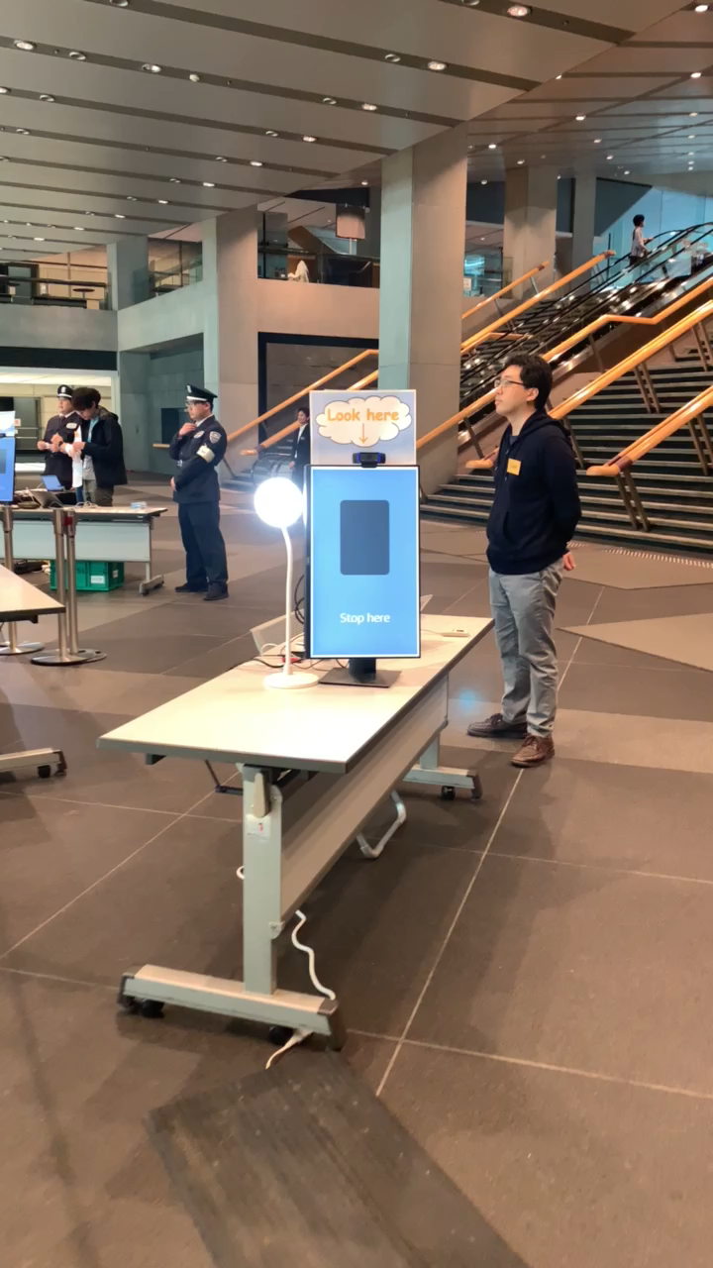










Auto Check-in with Amazon Comprehend
The Auto Check-In App automatically provisions the products and services necessary to configure facial comparison and search for event check-in. As part of your event check-in process, you take a picture of event attendees, and the solution sends them to Amazon Rekognition where the images are verified against a pre-registered attendee face collection.
Reception desk
AWS Cloud
Attendee
Camera
Amazon
Cognito
Amazon
Rekognition
AWS
Lambda
Amazon
S3 bucket
Attendees
(name & photo)
Operator
Amazon API Gateway
AWS
Lambda
Amazon
DynamoDB
Amazon
CloudWatch

Slide 74
Amazon Rekognition Workshop
TODO:
Add link

Slide 75
Train with your own algorithms
Single pass training
Train your models
easily using Amazon SageMaker
Distributed by default
Not memory bound
Train on a data stream
Checkpoint for re-training
Notes:
Training models is easy with Amazon SageMaker. When you’re ready to train in Amazon SageMaker, simply specify the location of your data in Amazon S3, and indicate the type and quantity of SageMaker ML instances you need, and get started with a single click. Amazon SageMaker sets up a distributed compute cluster, performs the training, outputs the result to Amazon S3, and tears down the cluster when complete.
When you specify the location of your data in Amazon S3, Amazon SageMaker will take your algorithm and run it on a training cluster isolated within its own software-defined network, configured to your needs. When you choose the instance type including Amazon EC2 P3dn, the most powerful GPU based instance in the cloud, Amazon SageMaker will create your cluster in an auto-scaling group. Amazon SageMaker will also attach EBS volumes to each node, set up the data pipelines, and start training with your TensorFlow, MXNet, Pytorch, Chainer or your framework script, built-in or custom algorithm. Once finished, the results are stored in S3 and the cluster is automatically torn down.
To make it easy to conduct training at scale, we’ve optimized how training data streams from Amazon S3. Through the API, you can specify if you’d like all of the data to be sent to each node in the cluster, or if you’d like Amazon SageMaker to manage the distribution of data across the nodes depending on the needs of your algorithm. Combined with the built-in algorithms, the scalability of training that’s possible with Amazon SageMaker can dramatically reduce the time and cost of training runs.

Slide 76
Amazon SageMaker has built-in algorithms or bring your own
Computer vision
Image classification | Object detection | Semantic segmentation
Topic modeling
LDA | NTM
Classification
Linear Learner | XGBoost | KNN
Recommendation
Factorization machines
Forecasting
DeepAR
Working with text
BlazingText | Supervised | Unsupervised
Regression
Linear Learner | XGBoost | KNN
Clustering
KMeans
Sequence translation
Seq2Seq
Anomaly detection
Random cut forests | IP Insights
Feature reduction
PCA
Notes:
Amazon SageMaker comes with dozens of pre-build algorithms. Amazon SageMaker provides high-performance, scalable machine learning algorithms, optimized for speed, scale, and accuracy, that can perform training on petabyte-scale data sets. You can choose from supervised algorithms where the correct answers are known during training and you can instruct the model where it made mistakes. Amazon SageMaker includes supervised algorithms such as XGBoost and linear/logistic regression or classification, to address recommendation and time series prediction problems. Amazon SageMaker also includes support for unsupervised learning (i.e. the algorithms must discover the correct answers on their own), such as with k-means clustering and principal component analysis (PCA), to solve problems like identifying customer groupings based on purchasing behavior.

Slide 77
Amazon Sagemaker Workshop
TODO:
Add link

Slide 78
Getting started on the journey
TRAINING
PROOF OF CONCEPT
PRODUCTION
Notes:
AWS has a number of trainings and acceleration programs to help you get started on your journey
We offer in-person trainings for both technical and business stakeholders as well as a full free online training and certification program for your developers.
We can conduct workshops to help you identify the best use cases for your business and work hand and hand with your team to develop a proof of concept through the ML Solutions Lab. And through our AWS ML Embark Program, we do in-person training for both business decision makers and technical staff, ideation on use cases, and development of a proof of concept.
Lastly, we have a Professional Services team as well as ML partners who can do end to end development and take your machine learning application to production.

Slide 79




Building your team’s skills
Hands-on learning
Training + certification
AWS DeepRacer Reinforcement Learning
AWS DeepComposer
Generative AI
AWS DeepLens
Deep Learning
AWS ML Training and Certification
Partnerships with MOOCs
Notes:
In parallel, you want to focus on building the right skills for your engineers.
We sometimes hear that organizations don’t move ahead because they feel like they don’t have the technical expertise to be successful.
The truth is, you can’t buy your way in to talent. There’s not enough and it can get very expensive. Instead you have to focus on developing internal talent.
But, we have seen that developers are able to obtain the right skills with a high success rate when engaged with good, hands-on training.
Amazon developed a machine learning university that we have used for over six years to train our engineers on ML.
Last year, we made a lot of this content available for free to customers and we have seen well over 100,000 developers start their ML journey with these content since. Having strong training programs can also help you attract and retain talent.
We’ve also brought additional programs to market like DeepRacer and DeepLens to get aspiring ML developers hands on with the technology.
AWS DeepRacer provides developers with the opportunity to learn, upskill, and get hands on with ML through a fully autonomous 1/18th scale race car driven by reinforcement learning, 3D racing simulator, and global racing league.
We hold corporate events designed to provide developers with a fun way to get introduced to essential ML concepts. Customers like Accenture, MorningStar and Liberty Mutual.
AWS DeepLens is commonly used for object detection and sentiment analysis projects.
Models trained in Amazon SageMaker can be sent to AWS DeepLens with just a few clicks from the AWS Management Console.

Slide 80
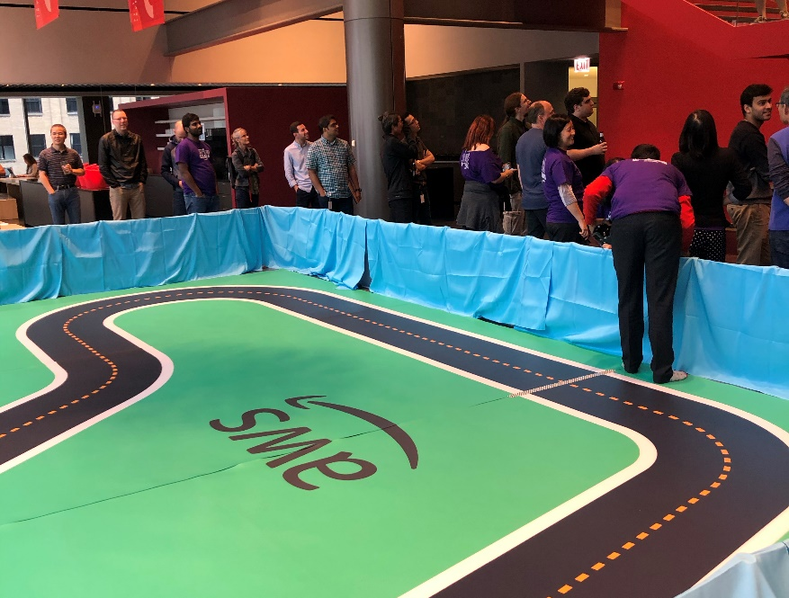

DeepRacer
Getting started with machine learning
Notes:
Morningstar uses AWS DeepRacer to provide hands-on training to their employees and accelerate their application of machine learning across its investing products, services and processes. More than 445 employees from multiple functions and 8 countries—including 35 percent of Morningstar's technology function—have been engaged in the AWS DeepRacer League.

Slide 81



The Amazon Machine Learning Solutions Lab
A range of ML engagements and use cases
Ideation through to production
Global footprint
Notes:
To help you identify a use case and bring it to proof of concept we have the Amazon ML Solutions Lab.
The ML Solutions Lab pairs your team with Amazon machine learning experts to prepare data, build and train models, and put models into production. It combines hands-on educational workshops with brainstorming sessions and advisory professional services to help you ‘work backwards’ from business challenges, and then go step-by-step through the process of developing machine learning-based solutions.
At the end of the program, you will be able to take what you have learned through the process and use it elsewhere in your organization to apply ML to business opportunities.

Slide 82

AWS Machine Learning Embark Program
DISCOVERY
Cross-functional workshops
TRAINING
In-person training
DEVELOPMENT
ML Solutions Lab
ENGAGEMENT
Get hands-on with DeepRacer
Notes:
The AWS machine learning Embark program is designed to start your company on the journey to machine learning success. The content is based on years of proven success helping organizations adopt ML, as well as Amazon’s own journey to put ML first in all areas of our business.
The program starts with an interactive workshop to identify the right business problem to tackle, followed by on-site, hands-on training to ramp up your company’s machine learning skills fast through practical application. Your developers then have the opportunity to partner with AWS machine learning experts from the ML Solutions Lab to build at least one proof of concept.
The program also includes a corporate AWS DeepRacer event to get your company motivated to embrace machine learning through hands-on friendly competition. With the practical skills, knowledge, and motivation derived from the program, your company will be ready to take your machine learning to the next stage.

Slide 83
ML.aws
Thank you!
Mustafa Aldemir

